Slide 1
Overburdened Communities in Rhode Island
Prepared by Michael Kearney

Slide 2
Overburdened Community: Definition
(a) “Overburdened Community” means any Census Tract in Rhode Island that:
(1) Is at or above the seventy fifth (75th) statewide percentile for at least three (3) of the following Environmental Indicators on the most recent available United States Environmental Protection Agency’s EJSCREEN Assessment: (a) PM 2.5; (b) Ozone; (c) NATA Diesel PM; (d) NATA Cancer Risk; (e) NATA Respiratory Hazard Index; (f) Traffic Proximity; (g) Lead Paint Indicator; (h) Superfund Proximity; (i) Risk Management Plan Facilities Proximity; (j) Hazardous Waste Proximity; and (k) Wastewater Discharge Indicator; and
(2) Has a median household income, as calculated by the US Census Bureau, that is no greater than eighty (80) percent of the statewide median household income, as calculated by the US Census Bureau.

Slide 3
Environmental Indicators: Definitions
PM 2.5: Particulate matter (PM2.5) levels in air, micrograms per cubic meter (µg/m3) annual average.
Ozone: Ozone summer seasonal avg. of daily maximum 8-hour concentration in air in parts per billion.
NATA Diesel PM: Diesel particulate matter level in air in micrograms per cubic meter (µg/m3).
NATA Cancer Risk: Lifetime cancer risk from inhalation of air toxics, as risk per lifetime per million people.
NATA Respiratory HI: Air toxics respiratory hazard index.
Traffic Proximity: Count of vehicles per day at major roads within 500 meters, divided by distance in meters.
Lead Paint Indicator: Percent of housing units built before 1960, as indicator of potential exposure to lead paint.
Superfund Proximity: Count of proposed and listed NPL sites within 5 km, each divided by distance. Count excludes deleted sites.
RMP Proximity: Count of RMP (potential chemical accident management plan) facilities within 5 km, each divided by distance.
Hazardous Waste Proximity: Count of TSDF (hazardous waste management facilities) within 5 km, each divided by distance.
Wastewater Discharge Indicator: RSEI modeled Toxic Concentrations at stream segments within 500 meters, divided by distance.

Slide 4
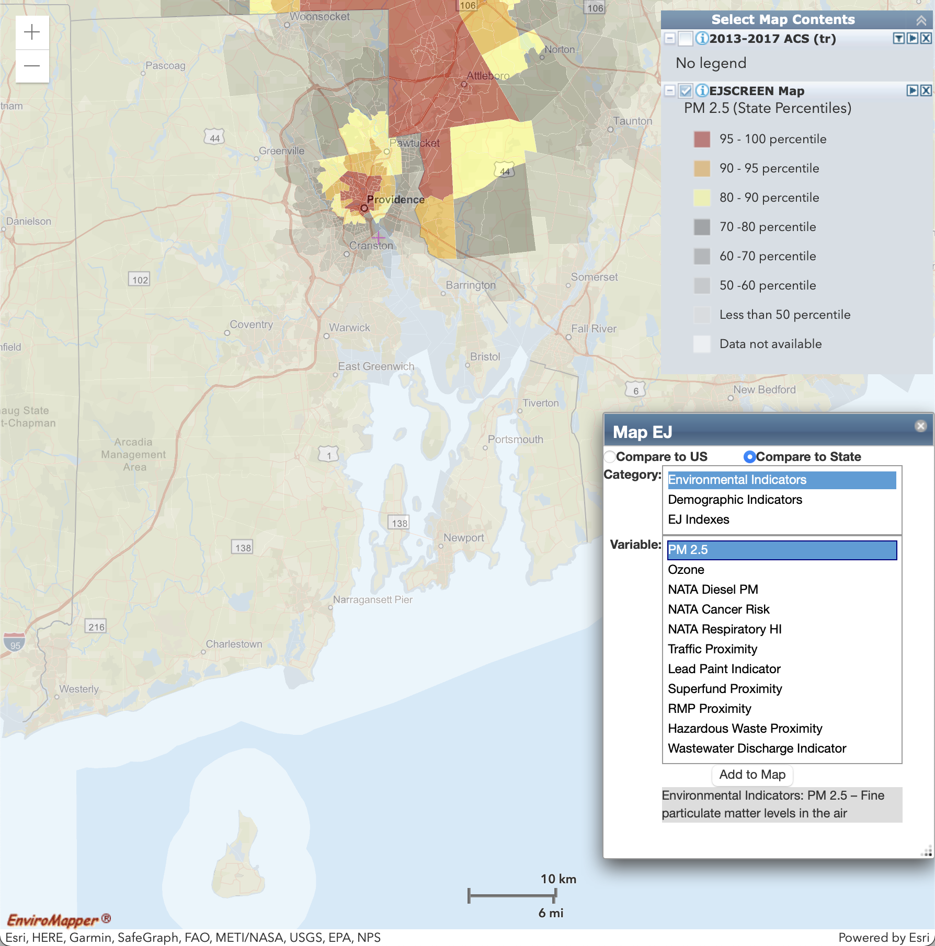
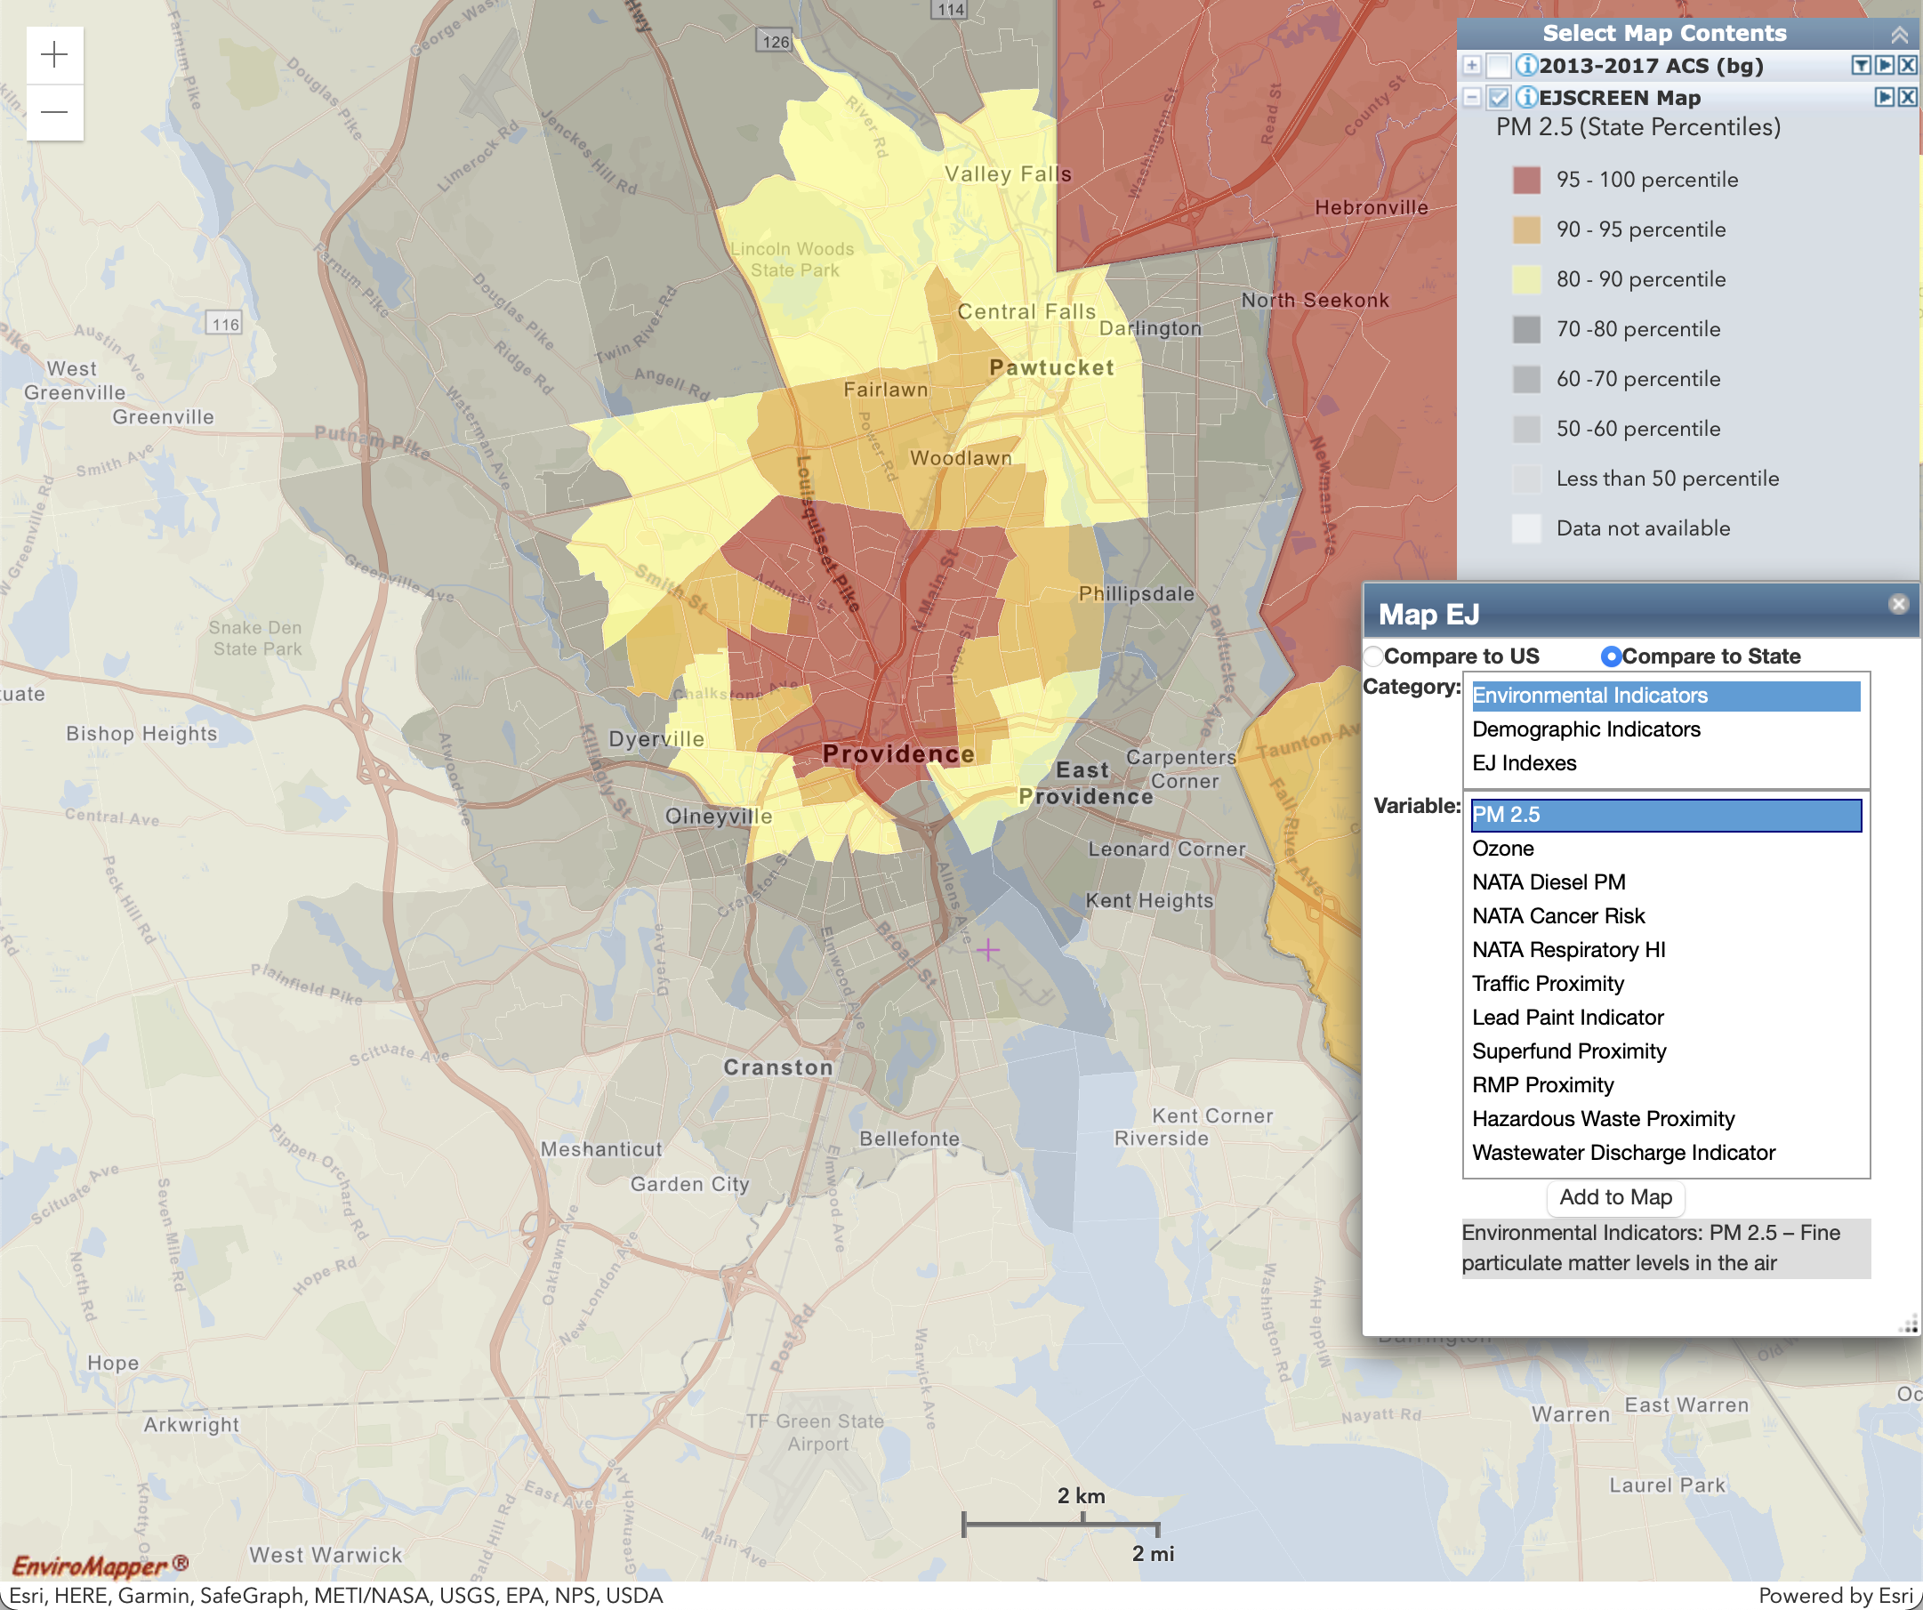
Environmental Indicator: PM 2.5
Particulate matter (PM2.5) levels in air, micrograms per cubic meter (µg/m3) annual average.
Statewide (Block Group)
Providence Metro Inset (Census Tract)

Slide 5
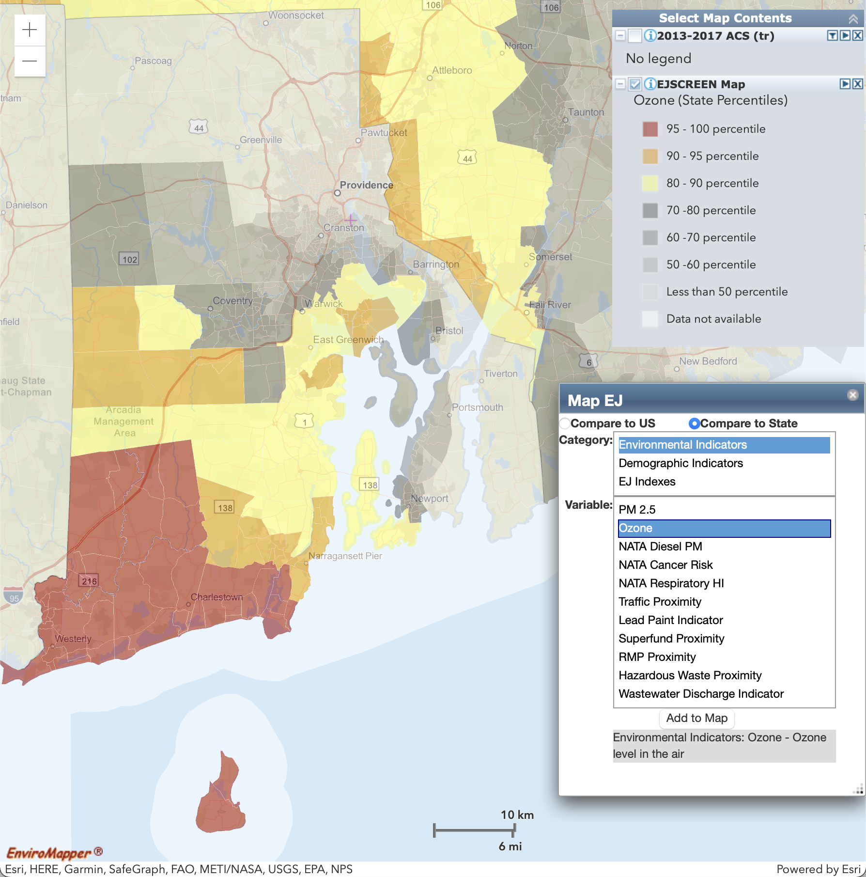
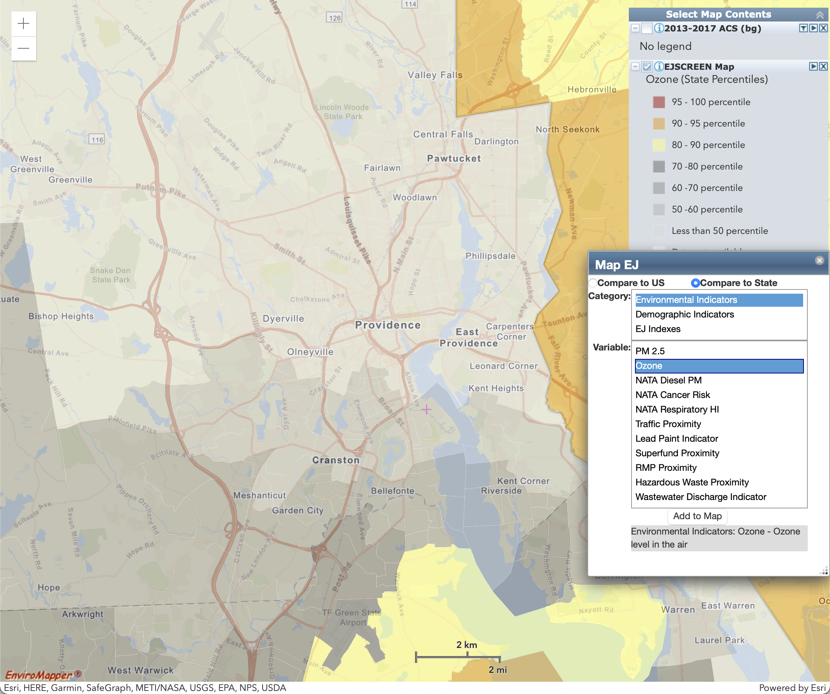
Environmental Indicator: Ozone
Ozone summer seasonal avg. of daily maximum 8-hour concentration in air in parts per billion.
Statewide (Block Group)
Providence Metro Inset (Census Tract)

Slide 6
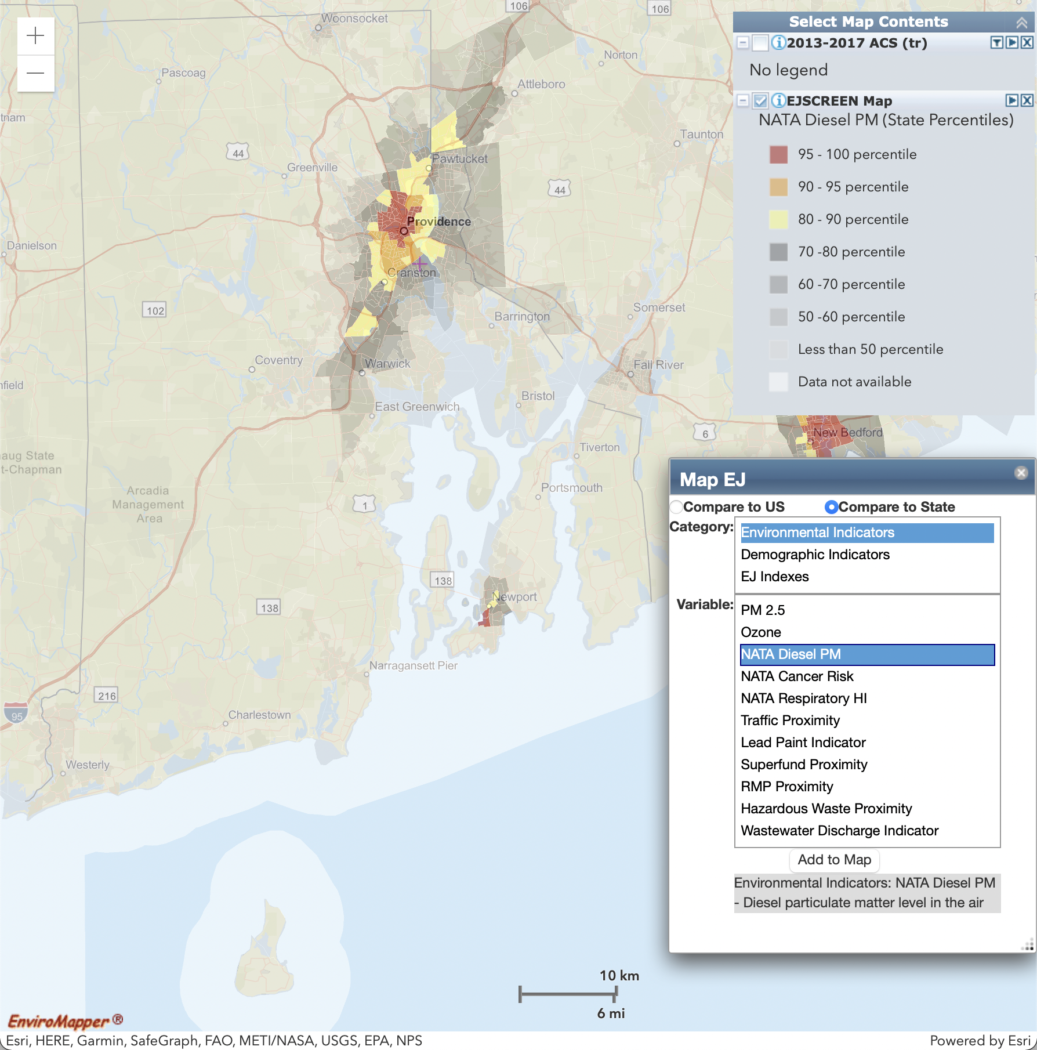
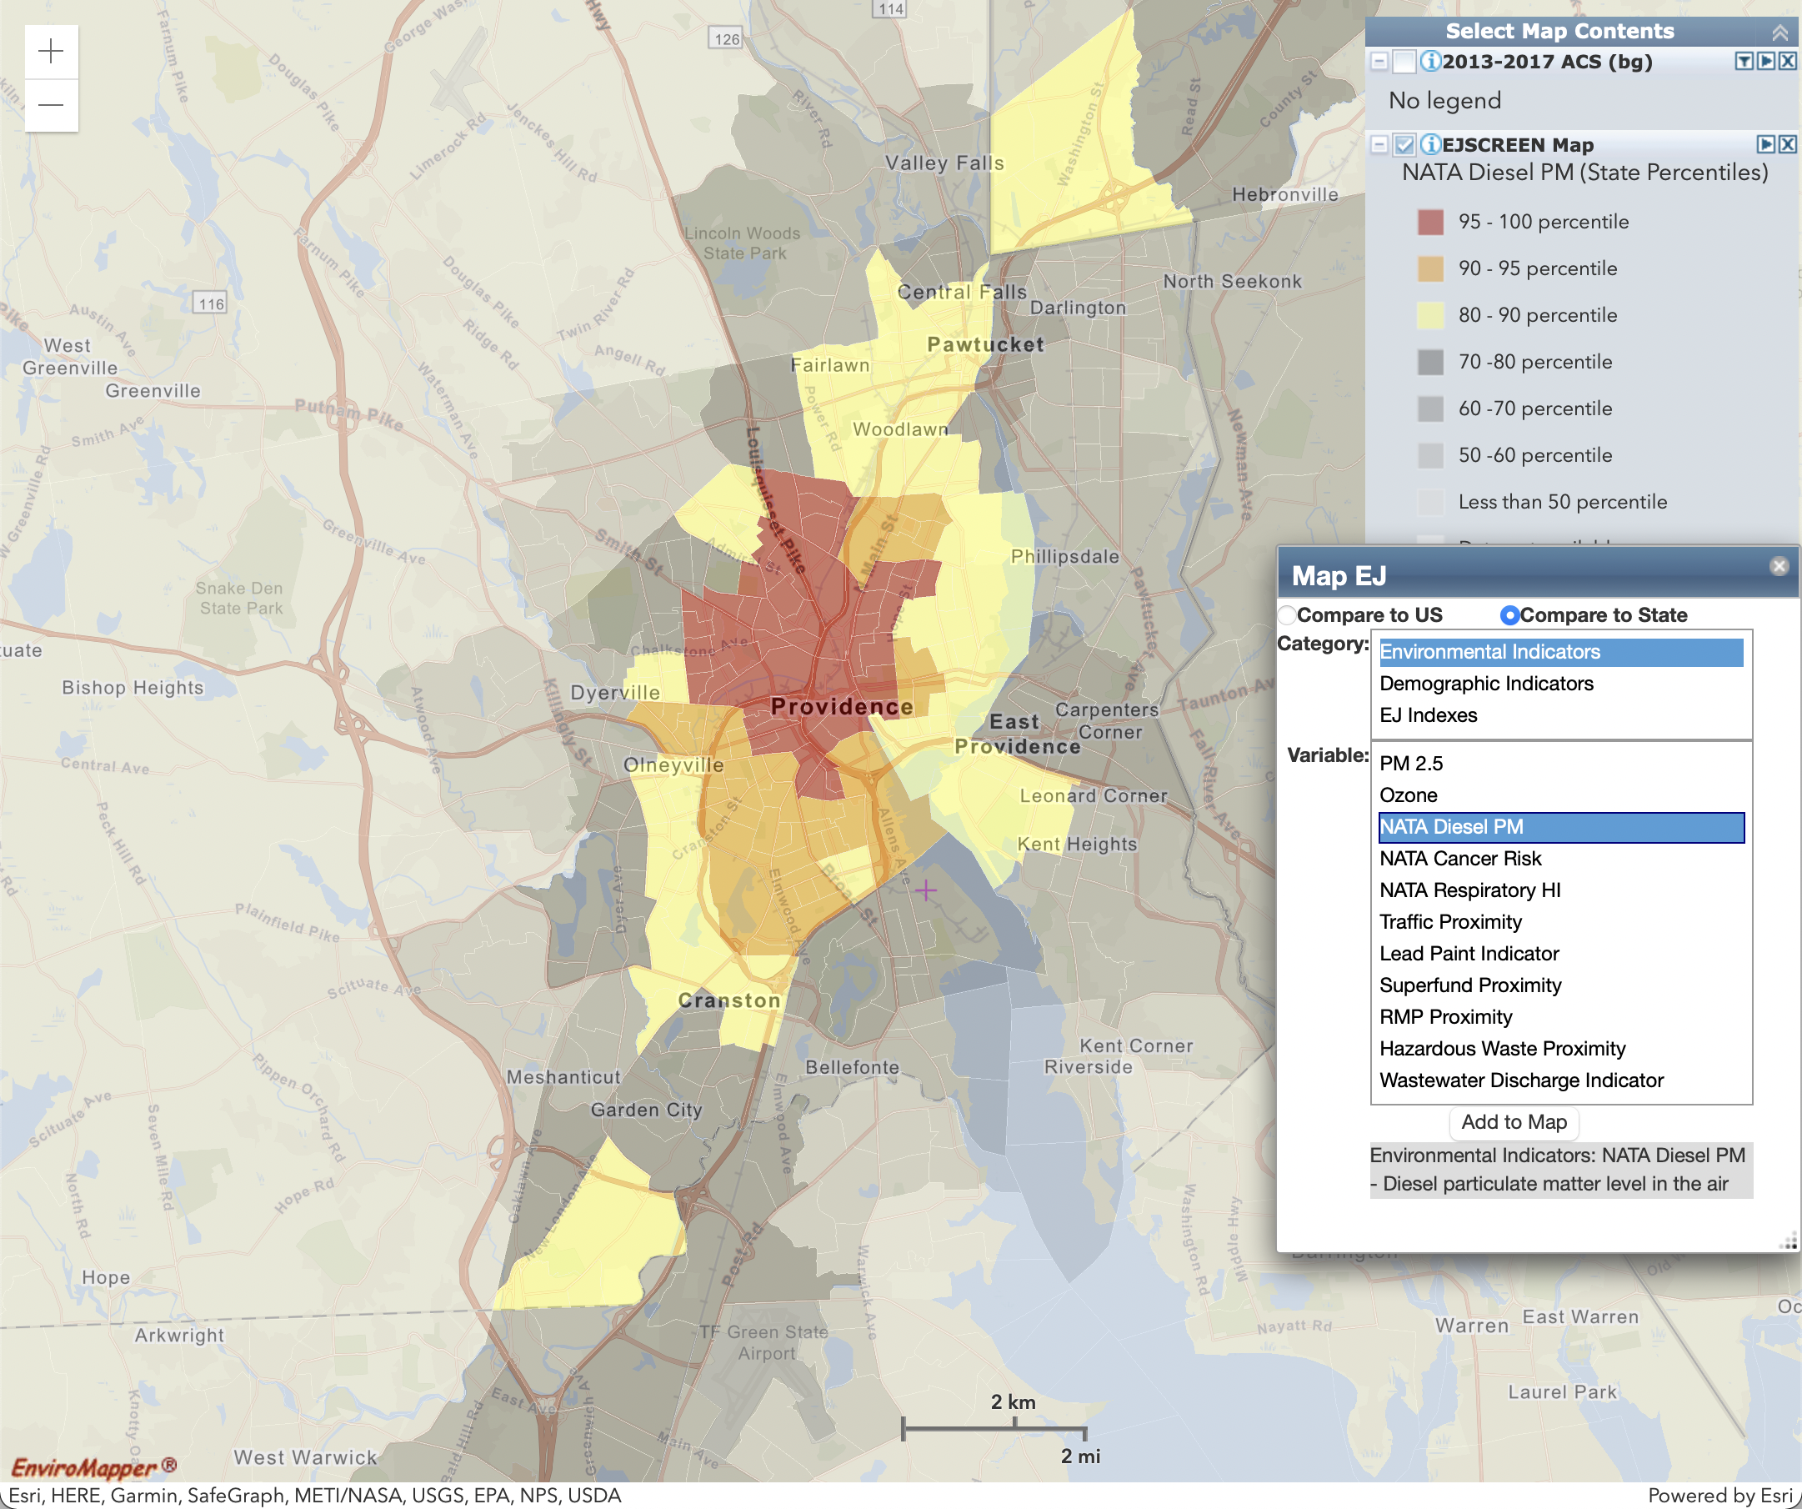
Environmental Indicator: NATA Diesel PM
Diesel particulate matter level in air in micrograms per cubic meter (µg/m3).
Statewide (Block Group)
Providence Metro Inset (Census Tract)

Slide 7
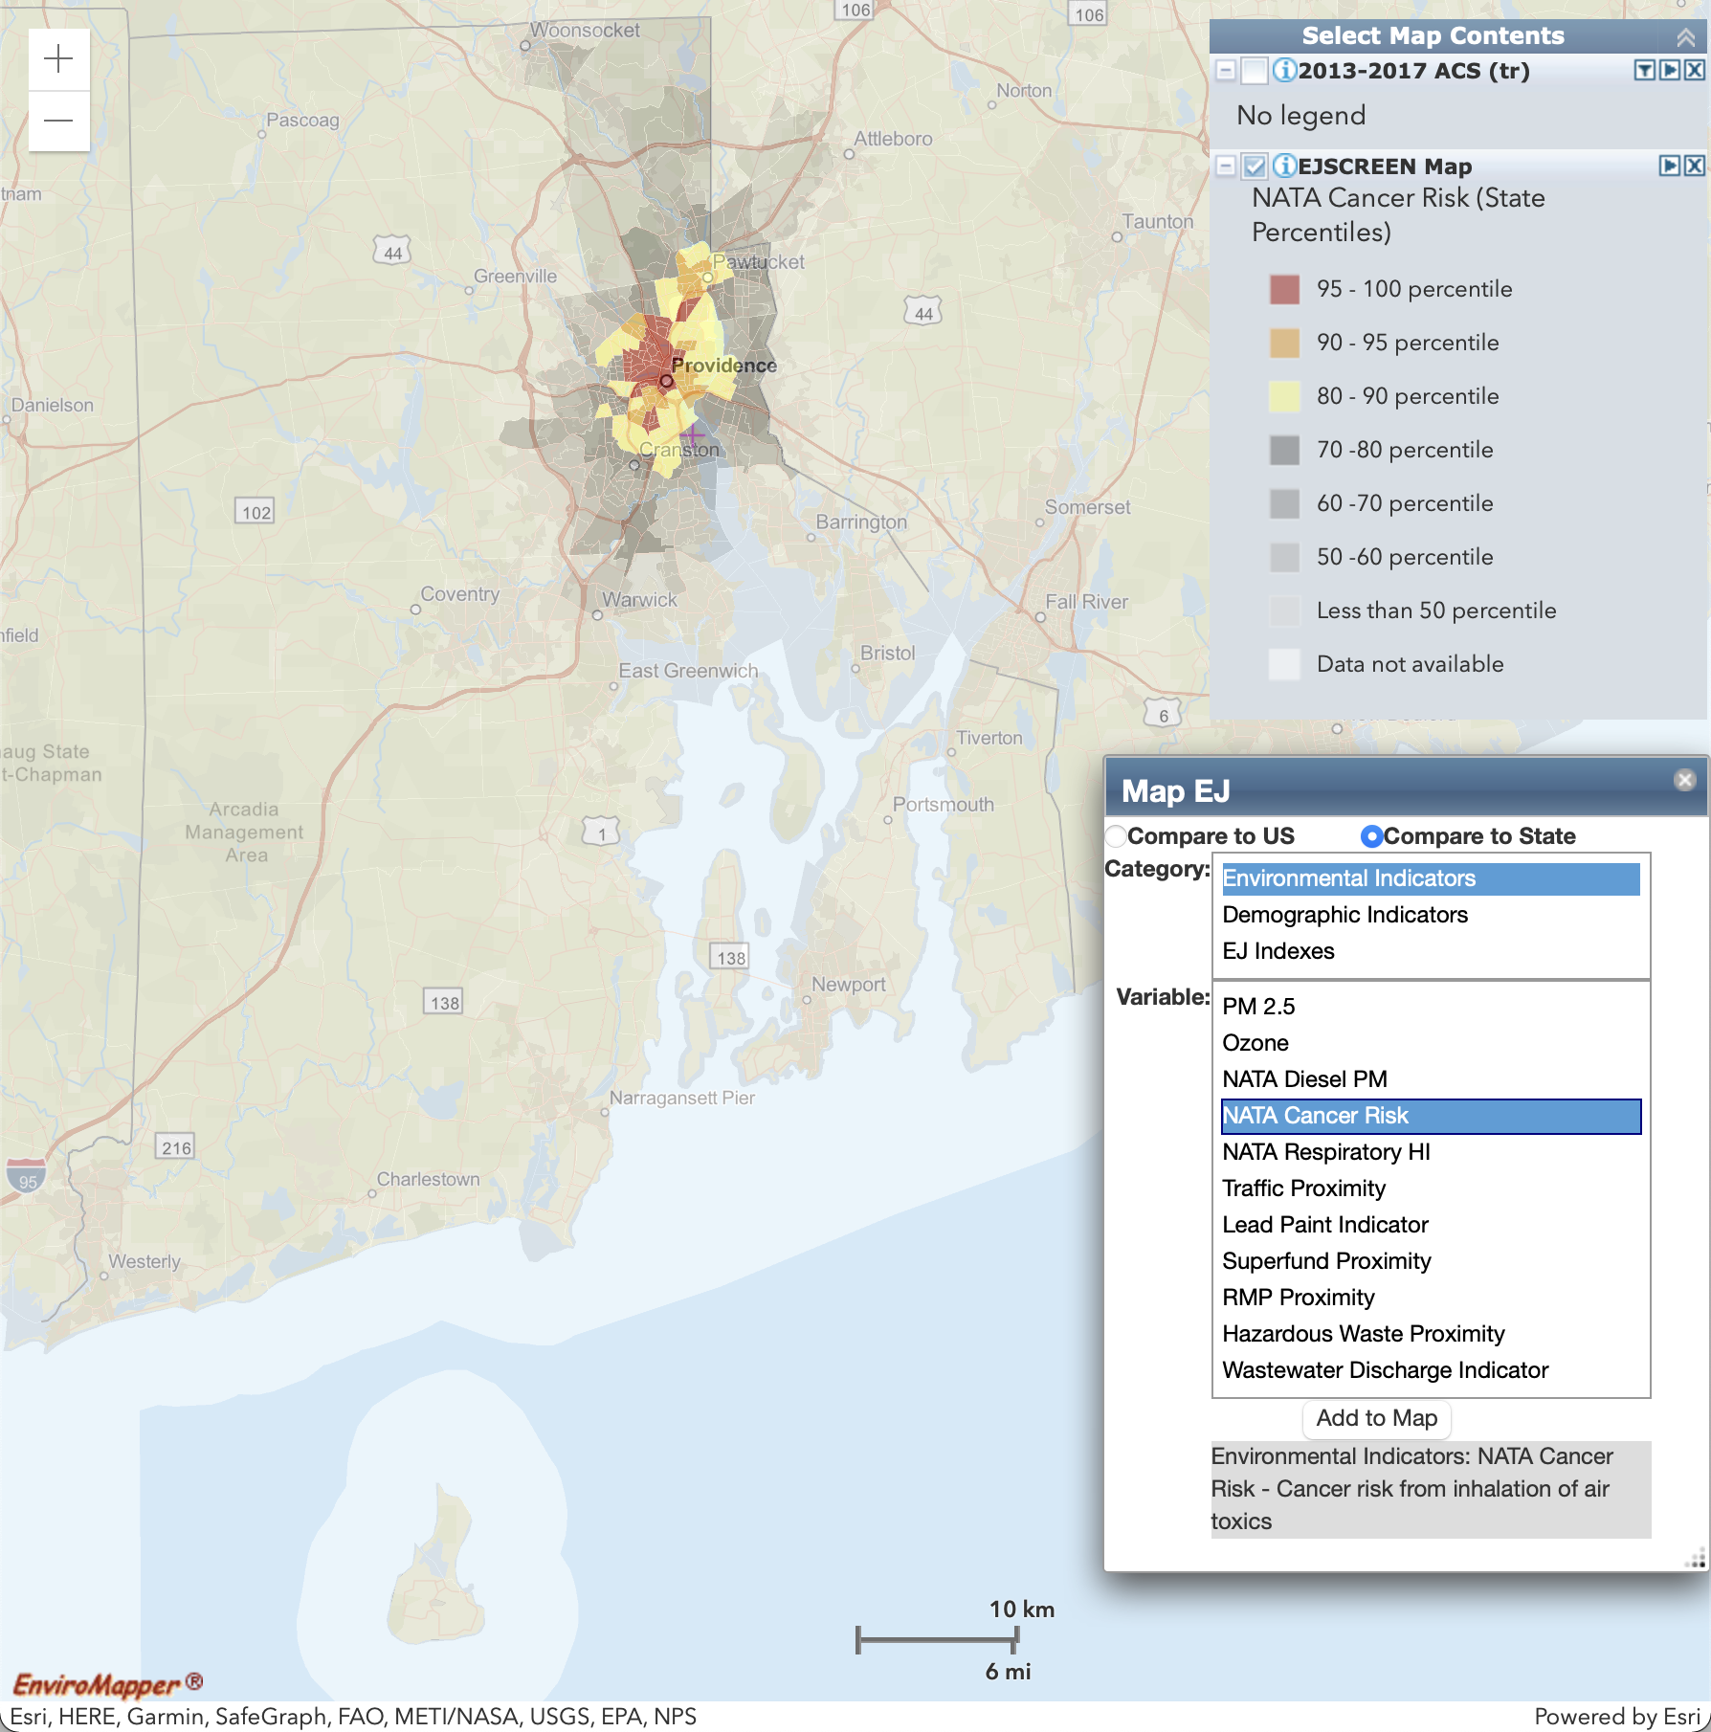
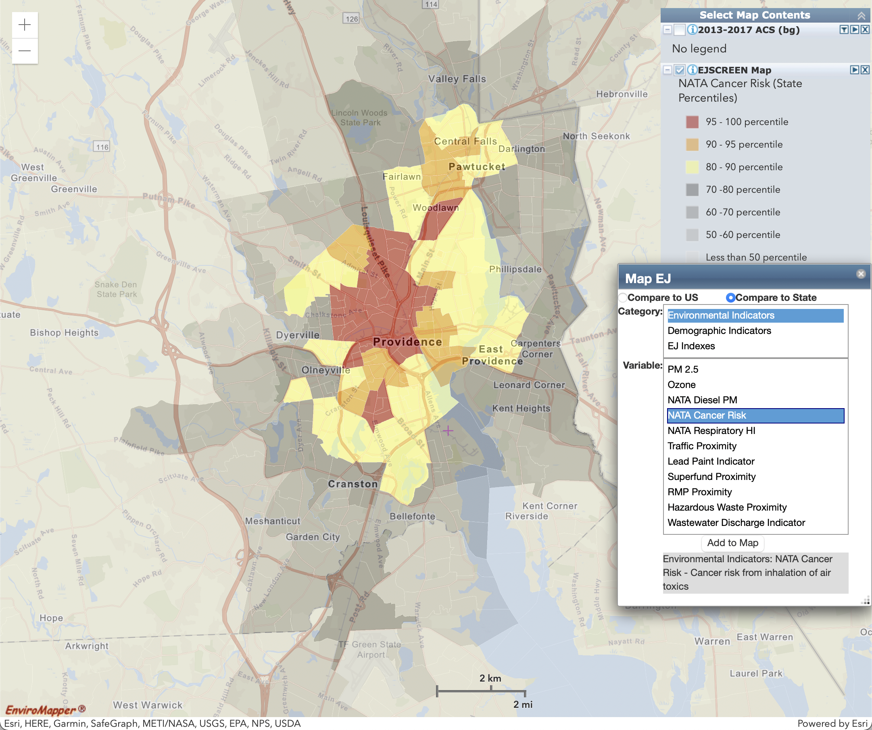
Environmental Indicator: NATA Cancer Risk
Lifetime cancer risk from inhalation of air toxics, as risk per lifetime per million people.
Statewide (Block Group)
Providence Metro Inset (Census Tract)

Slide 8
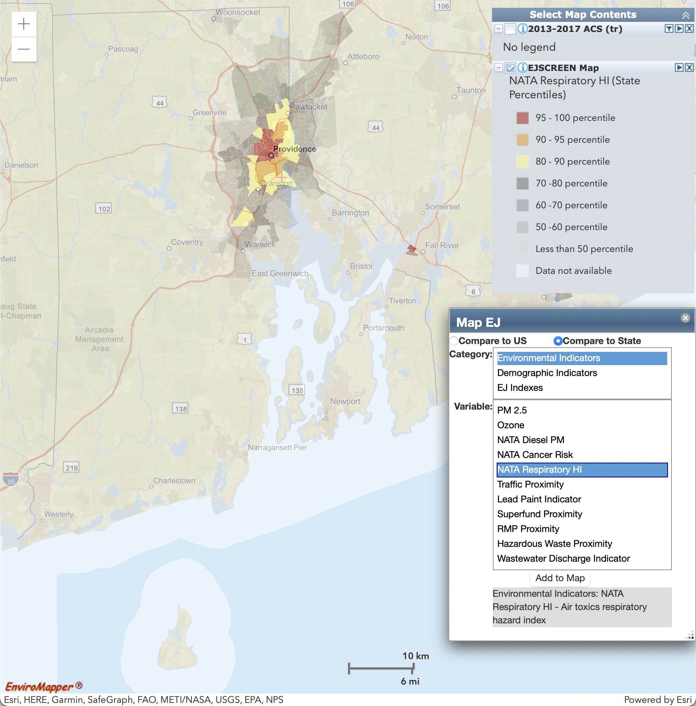
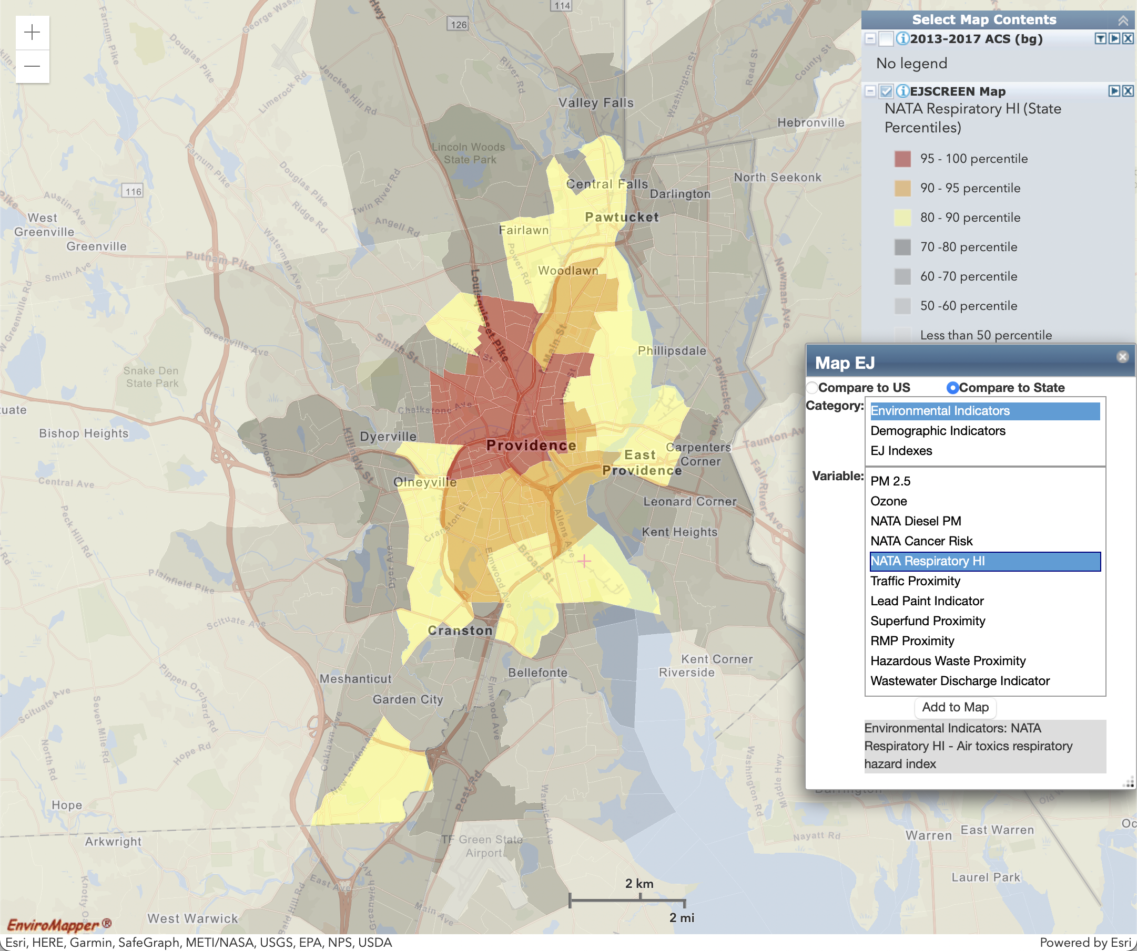
Environmental Indicator: NATA Respiratory HI
Air toxics respiratory hazard index.
Statewide (Block Group)
Providence Metro Inset (Census Tract)

Slide 9
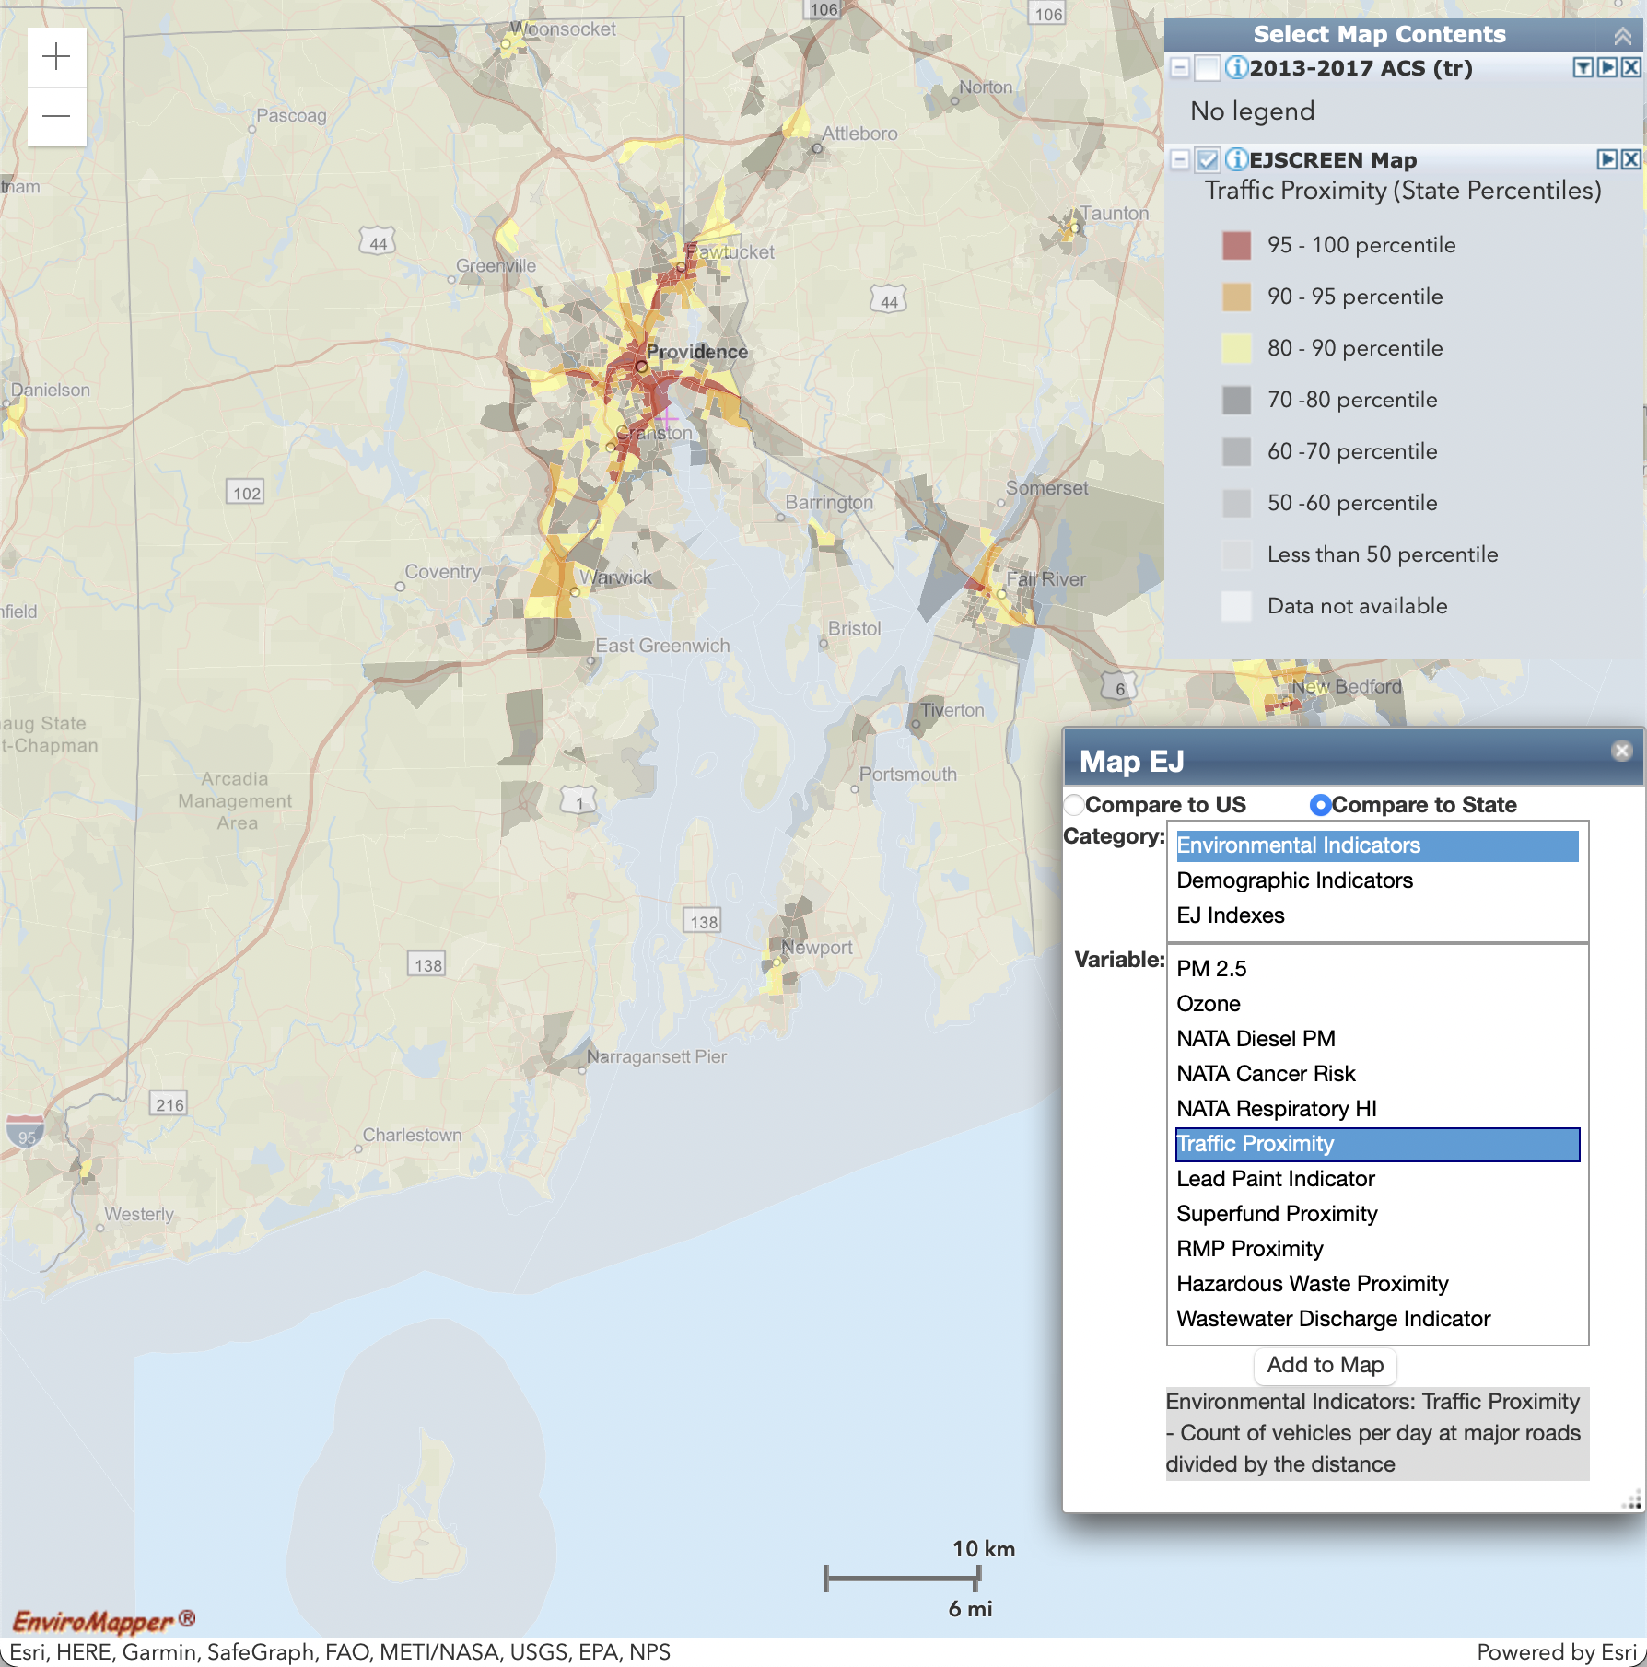
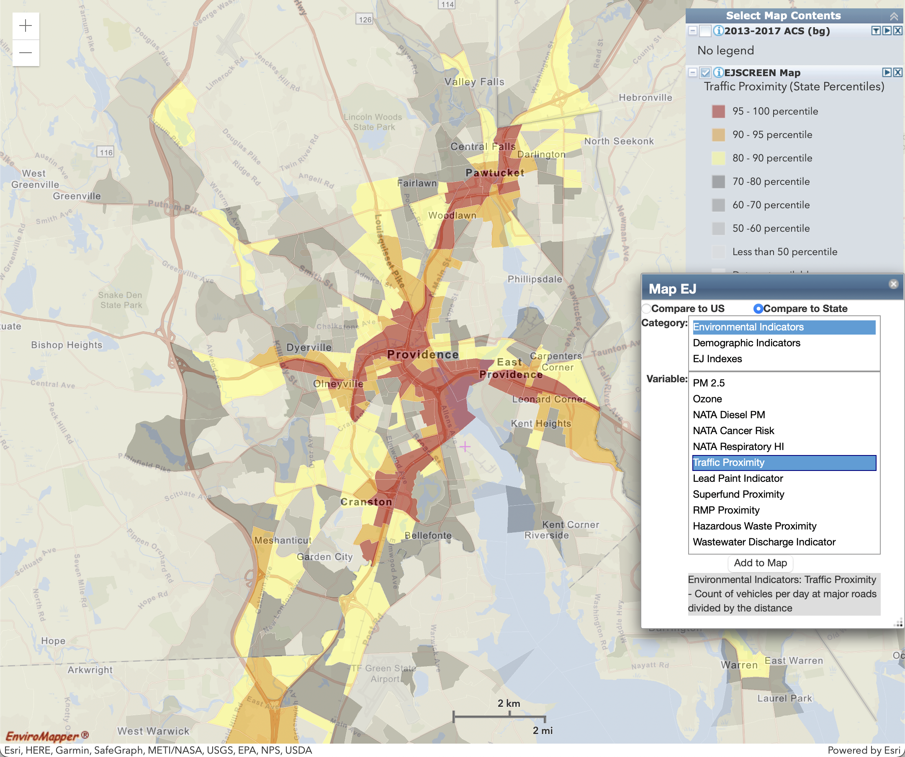
Environmental Indicator: Traffic Proximity
Count of vehicles per day at major roads within 500 meters, divided by distance in meters.
Statewide (Block Group)
Providence Metro Inset (Census Tract)

Slide 10
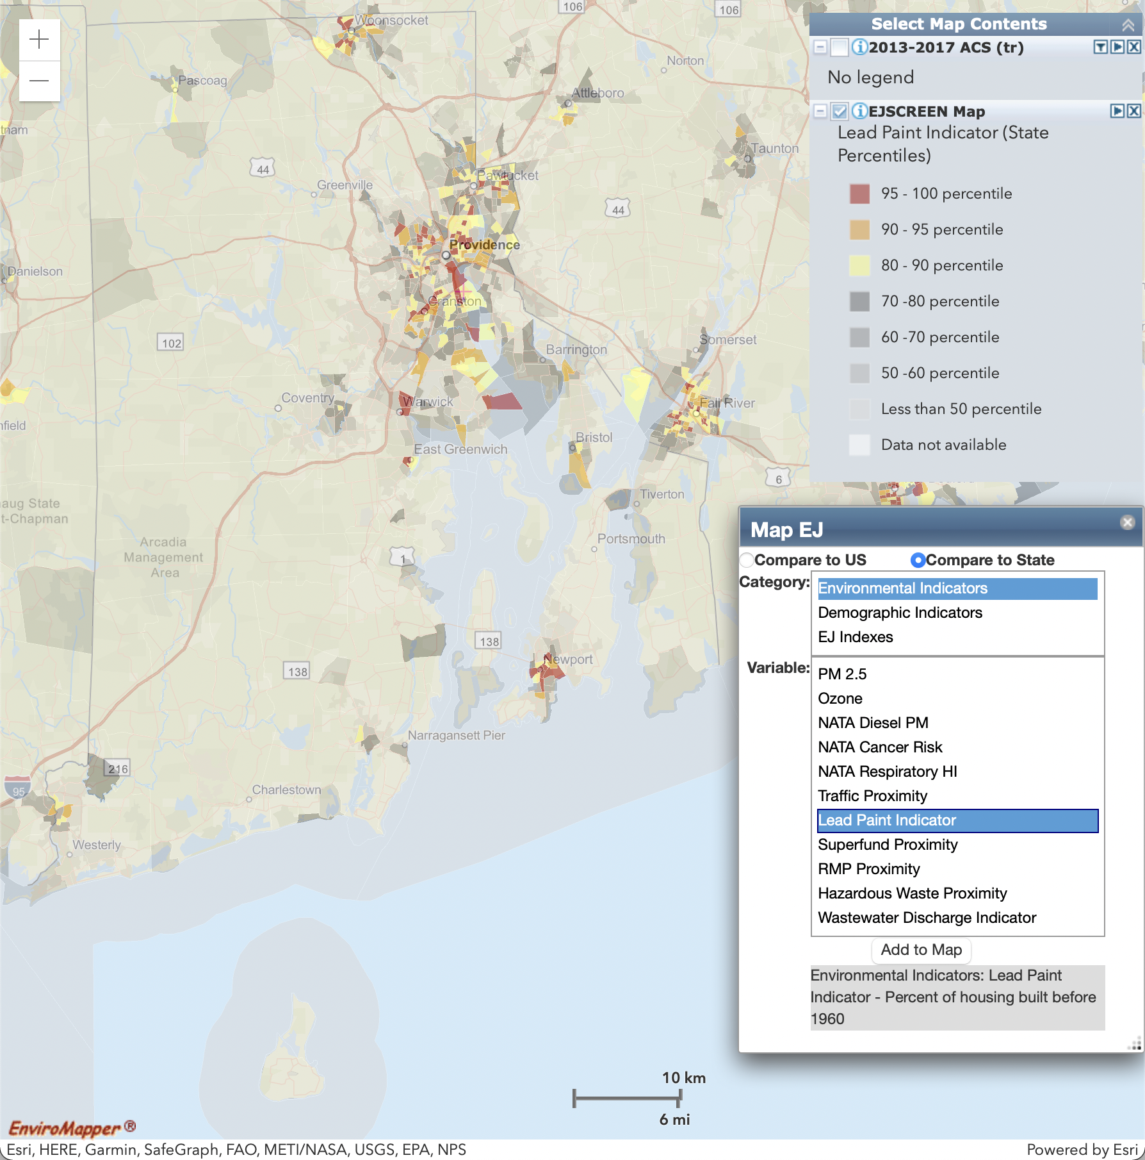
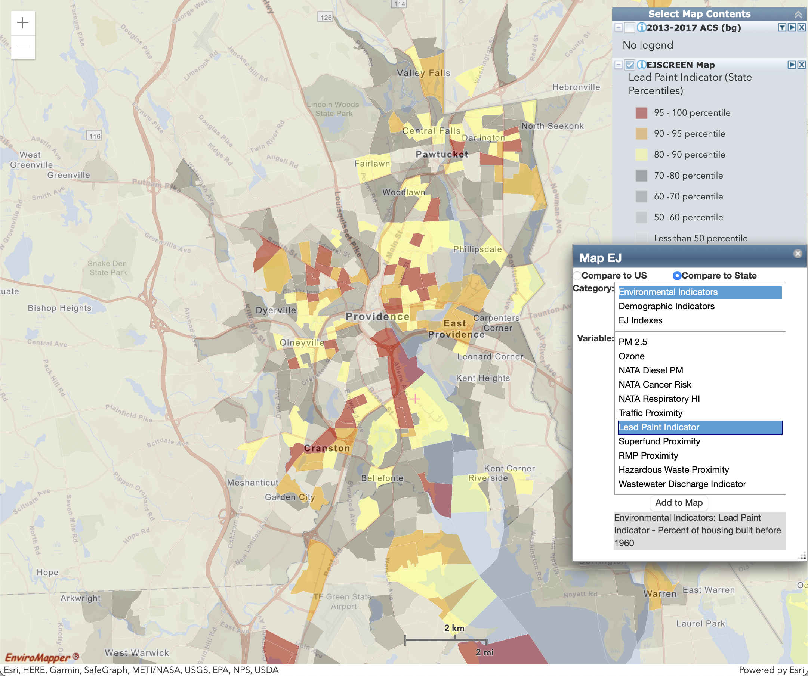
Environmental Indicator: Lead Paint Indicator
Percent of housing units built before 1960, as indicator of potential exposure to lead paint.
Statewide (Block Group)
Providence Metro Inset (Census Tract)

Slide 11
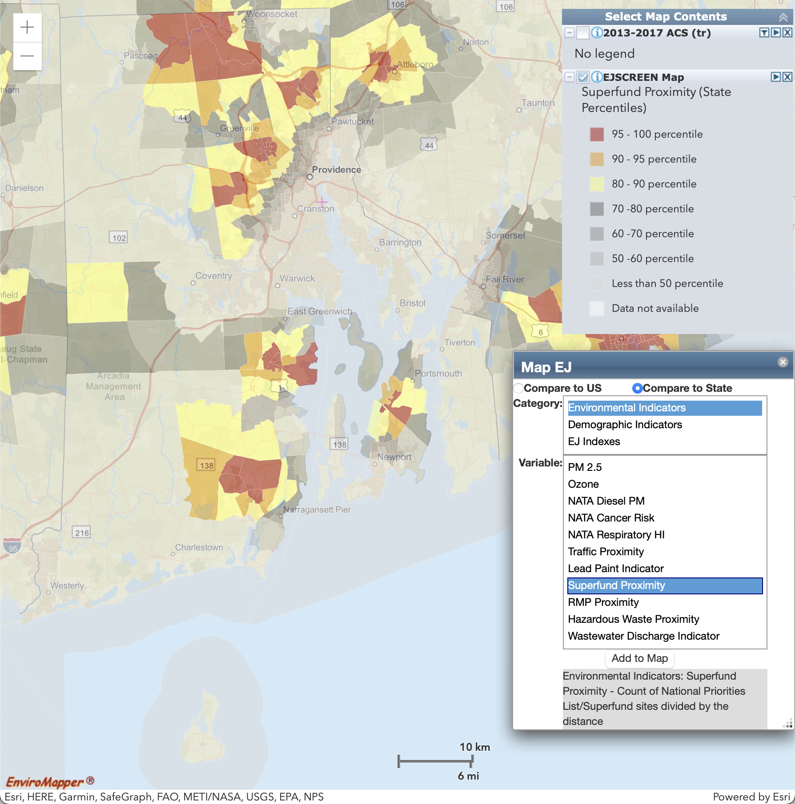
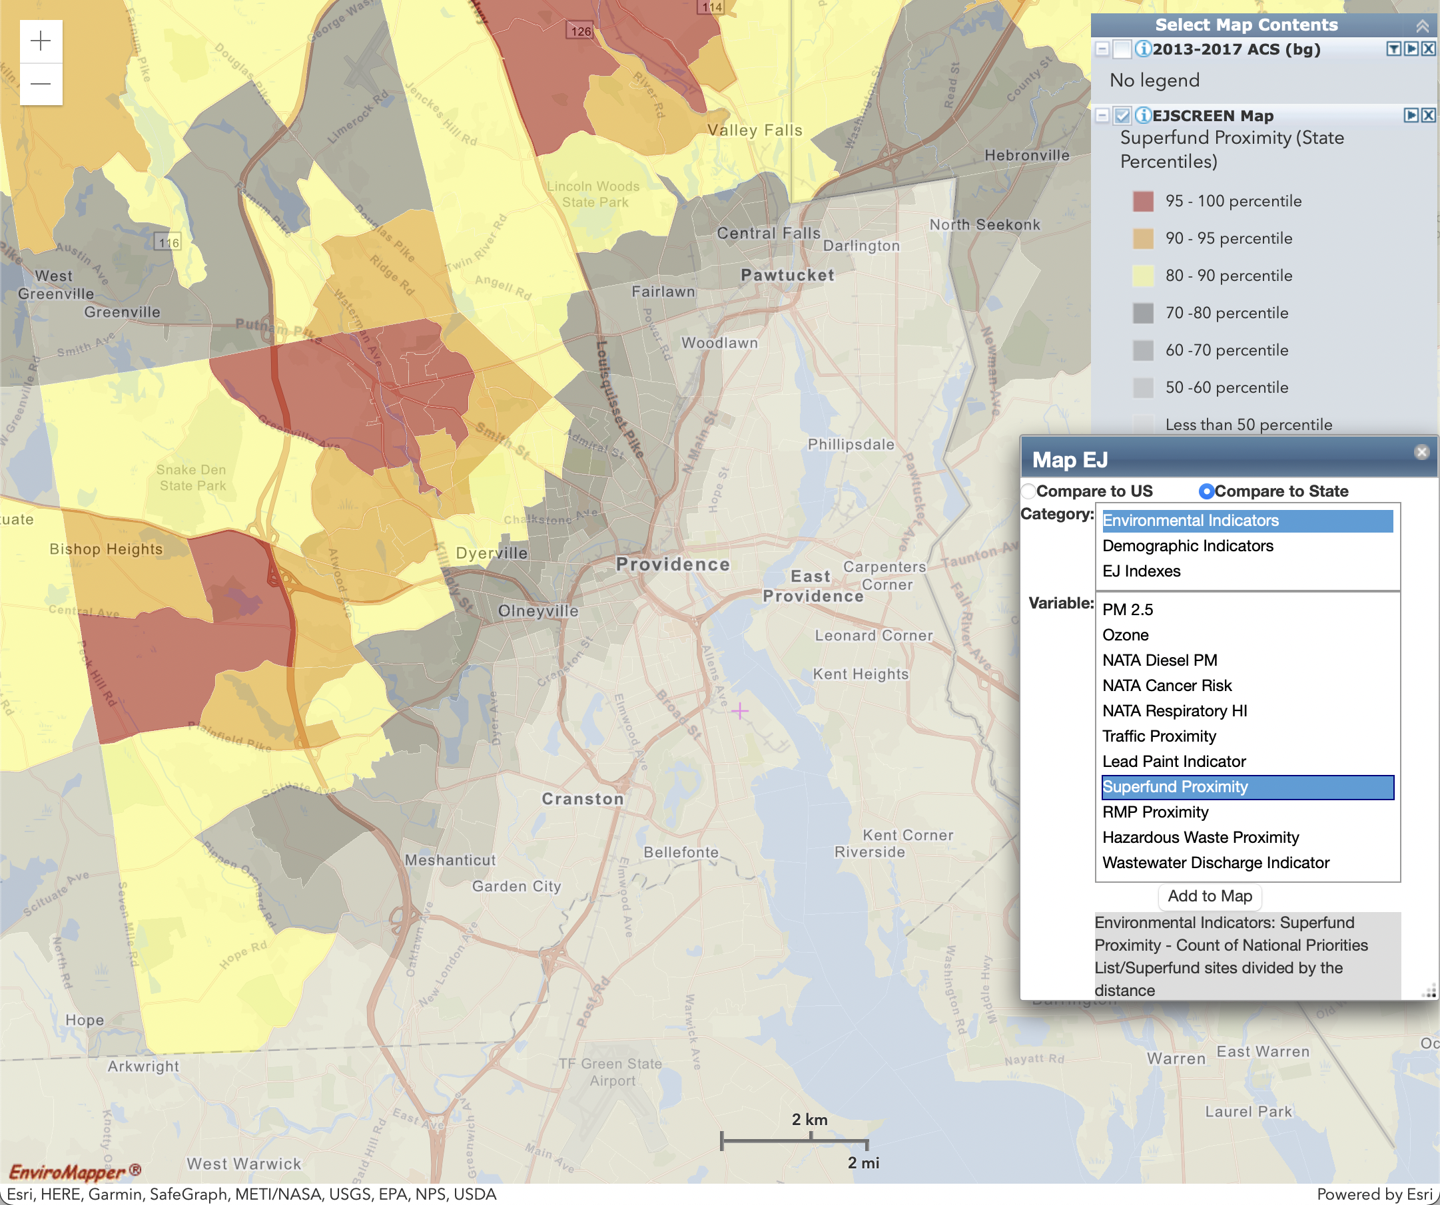
Environmental Indicator: Superfund Proximity
Count of proposed and listed NPL sites within 5 km, each divided by distance. Count excludes deleted sites.
Statewide (Block Group)
Providence Metro Inset (Census Tract)

Slide 12
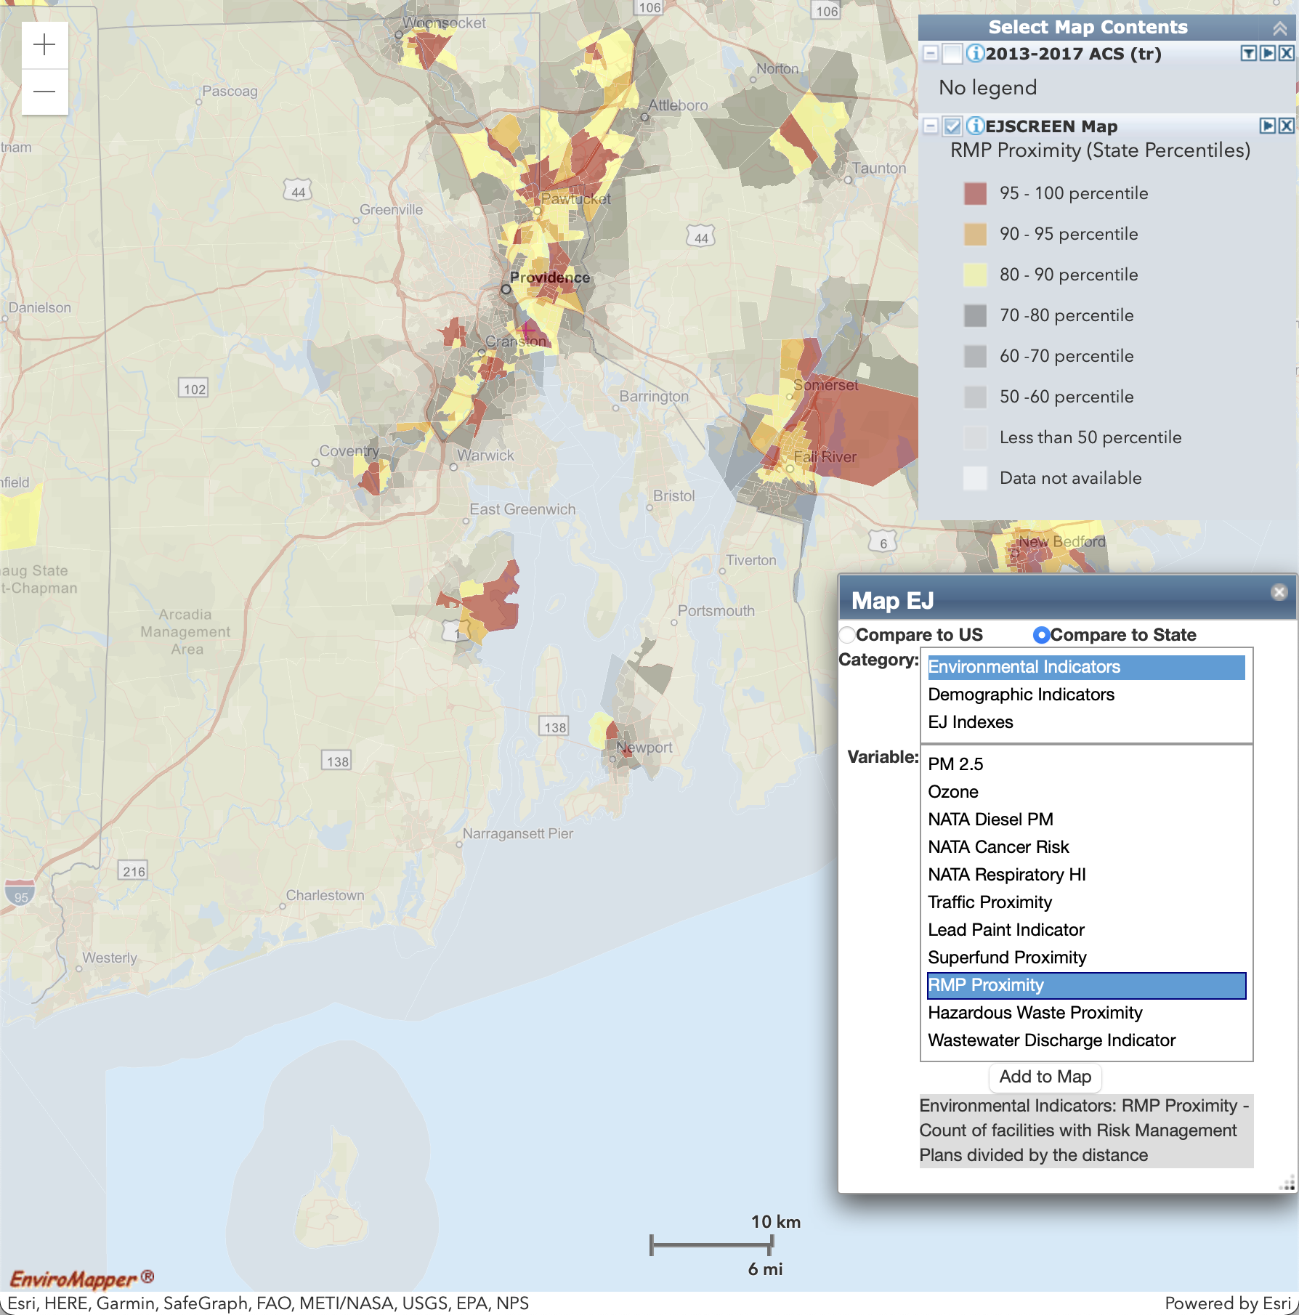
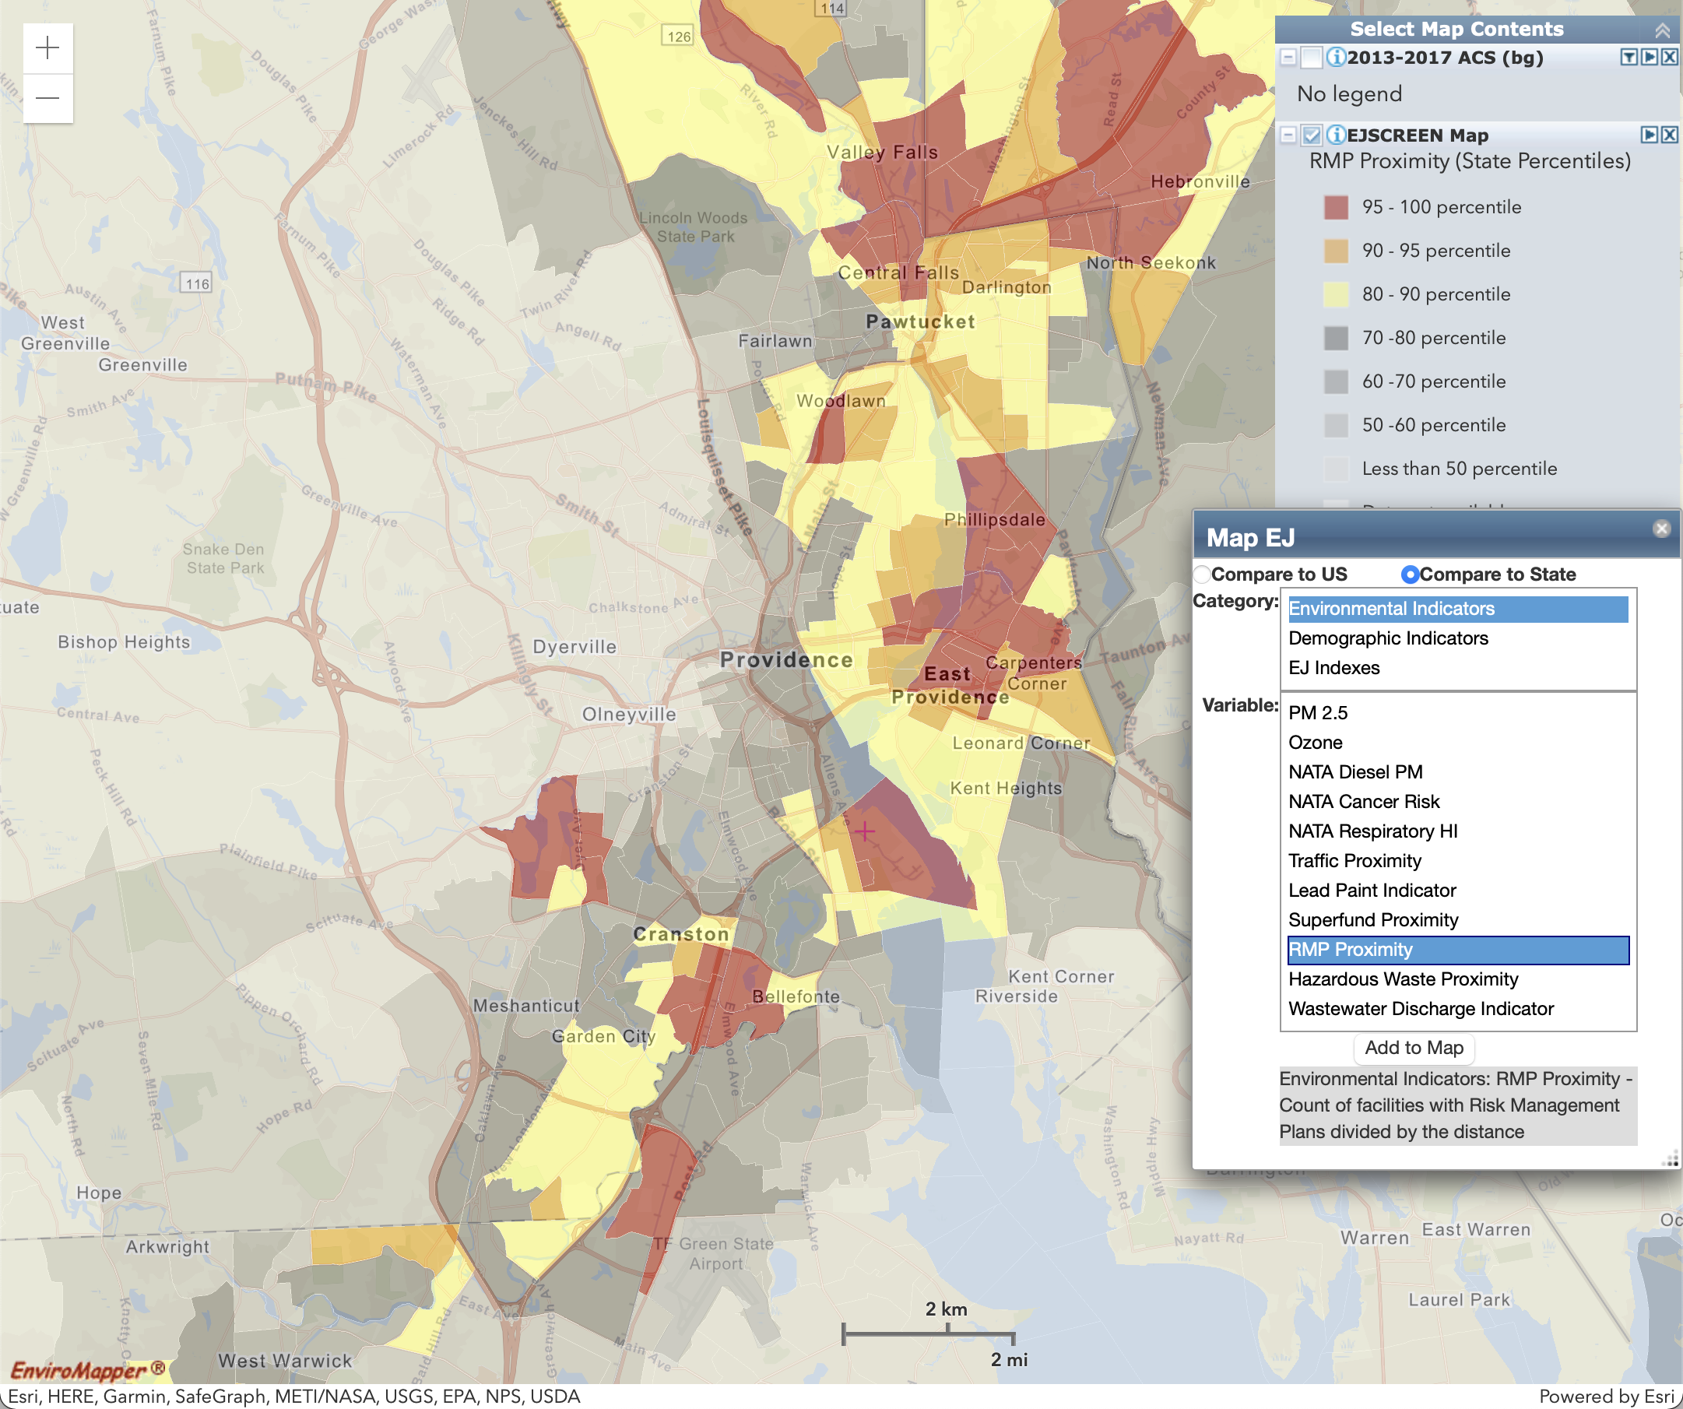
Environmental Indicator: RMP Proximity
Count of RMP (potential chemical accident management plan) facilities within 5 km, each divided by distance.
Statewide (Block Group)
Providence Metro Inset (Census Tract)

Slide 13
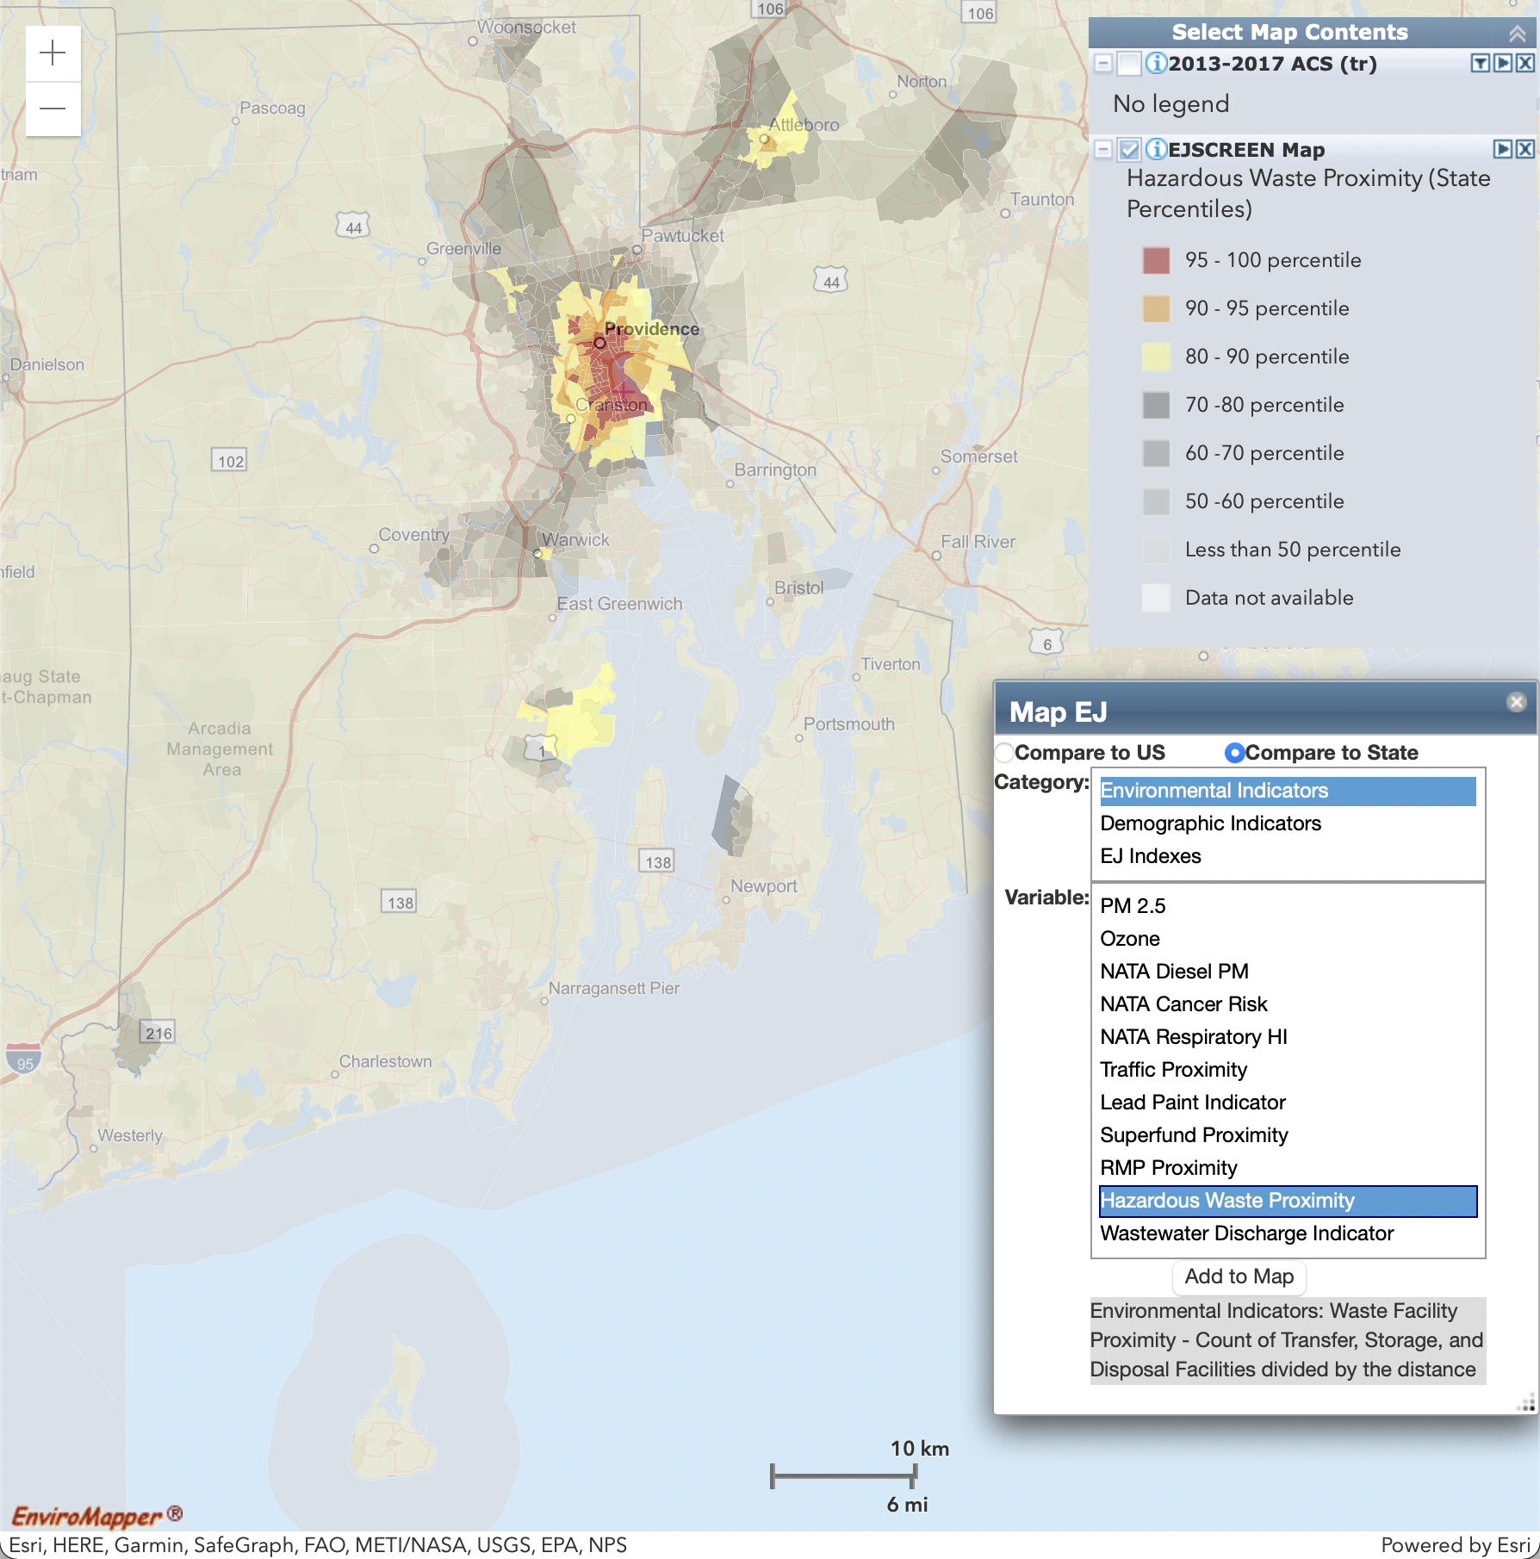
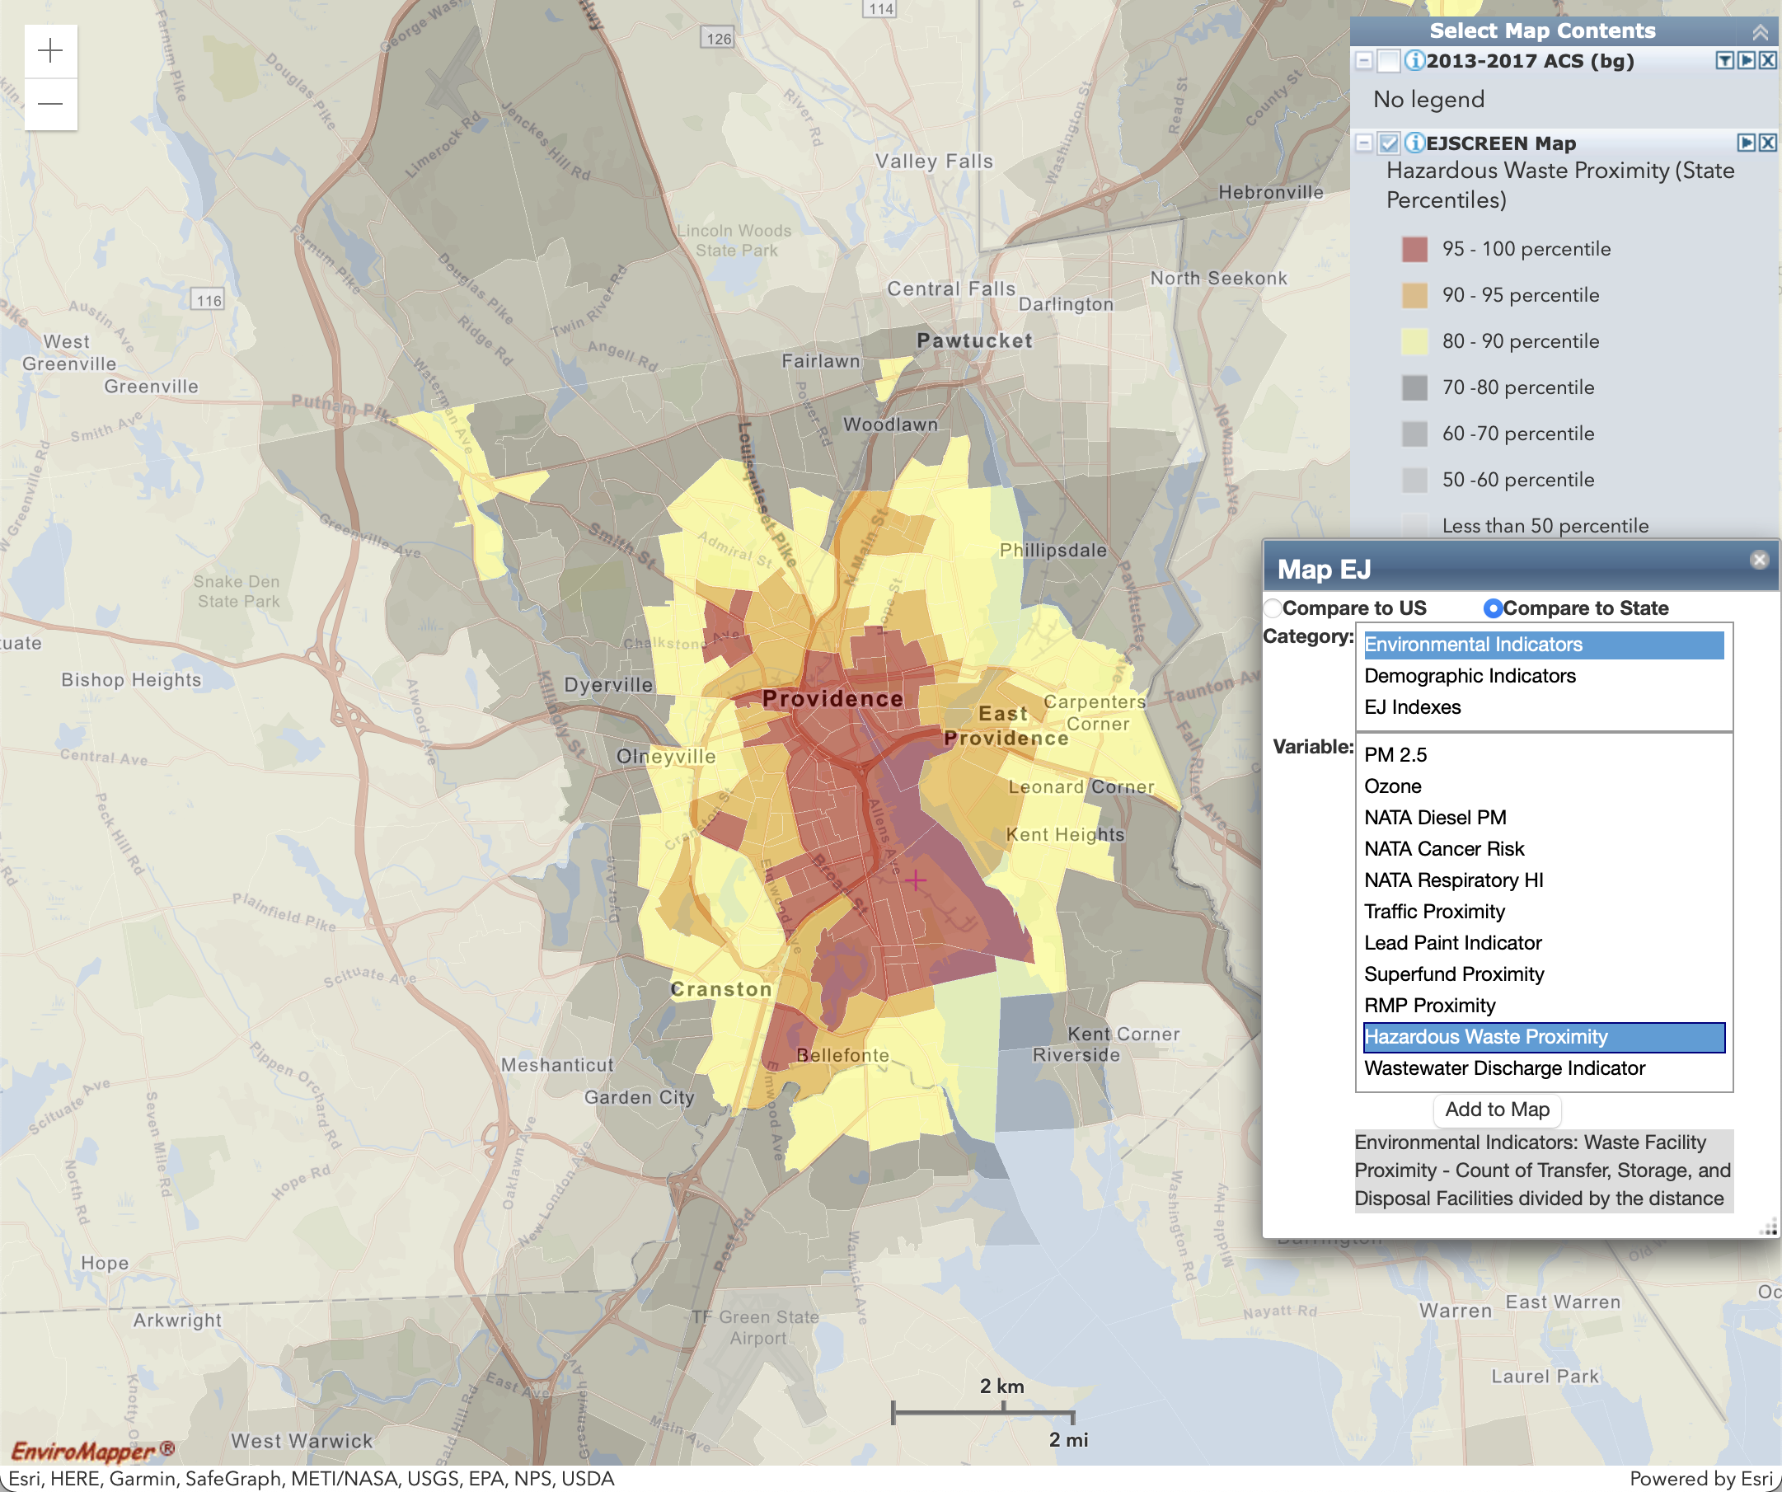
Environmental Indicator: Hazardous Waste Proximity
Count of TSDF (hazardous waste management facilities) within 5 km, each divided by distance.
Statewide (Block Group)
Providence Metro Inset (Census Tract)

Slide 14
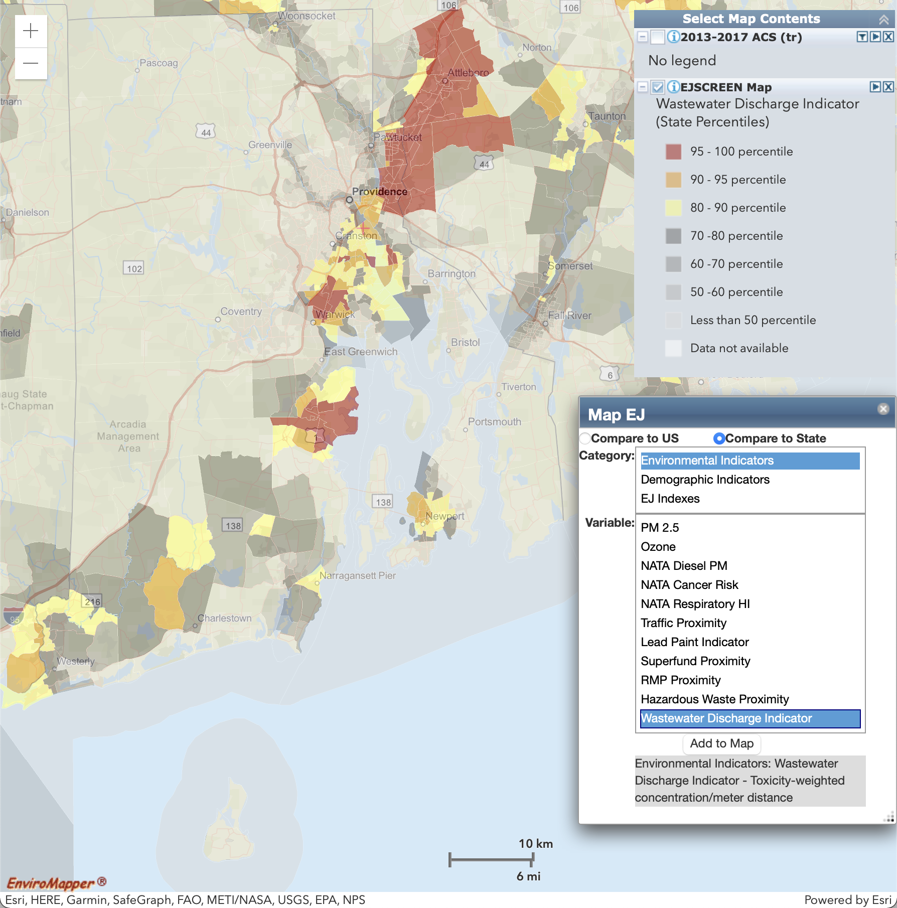
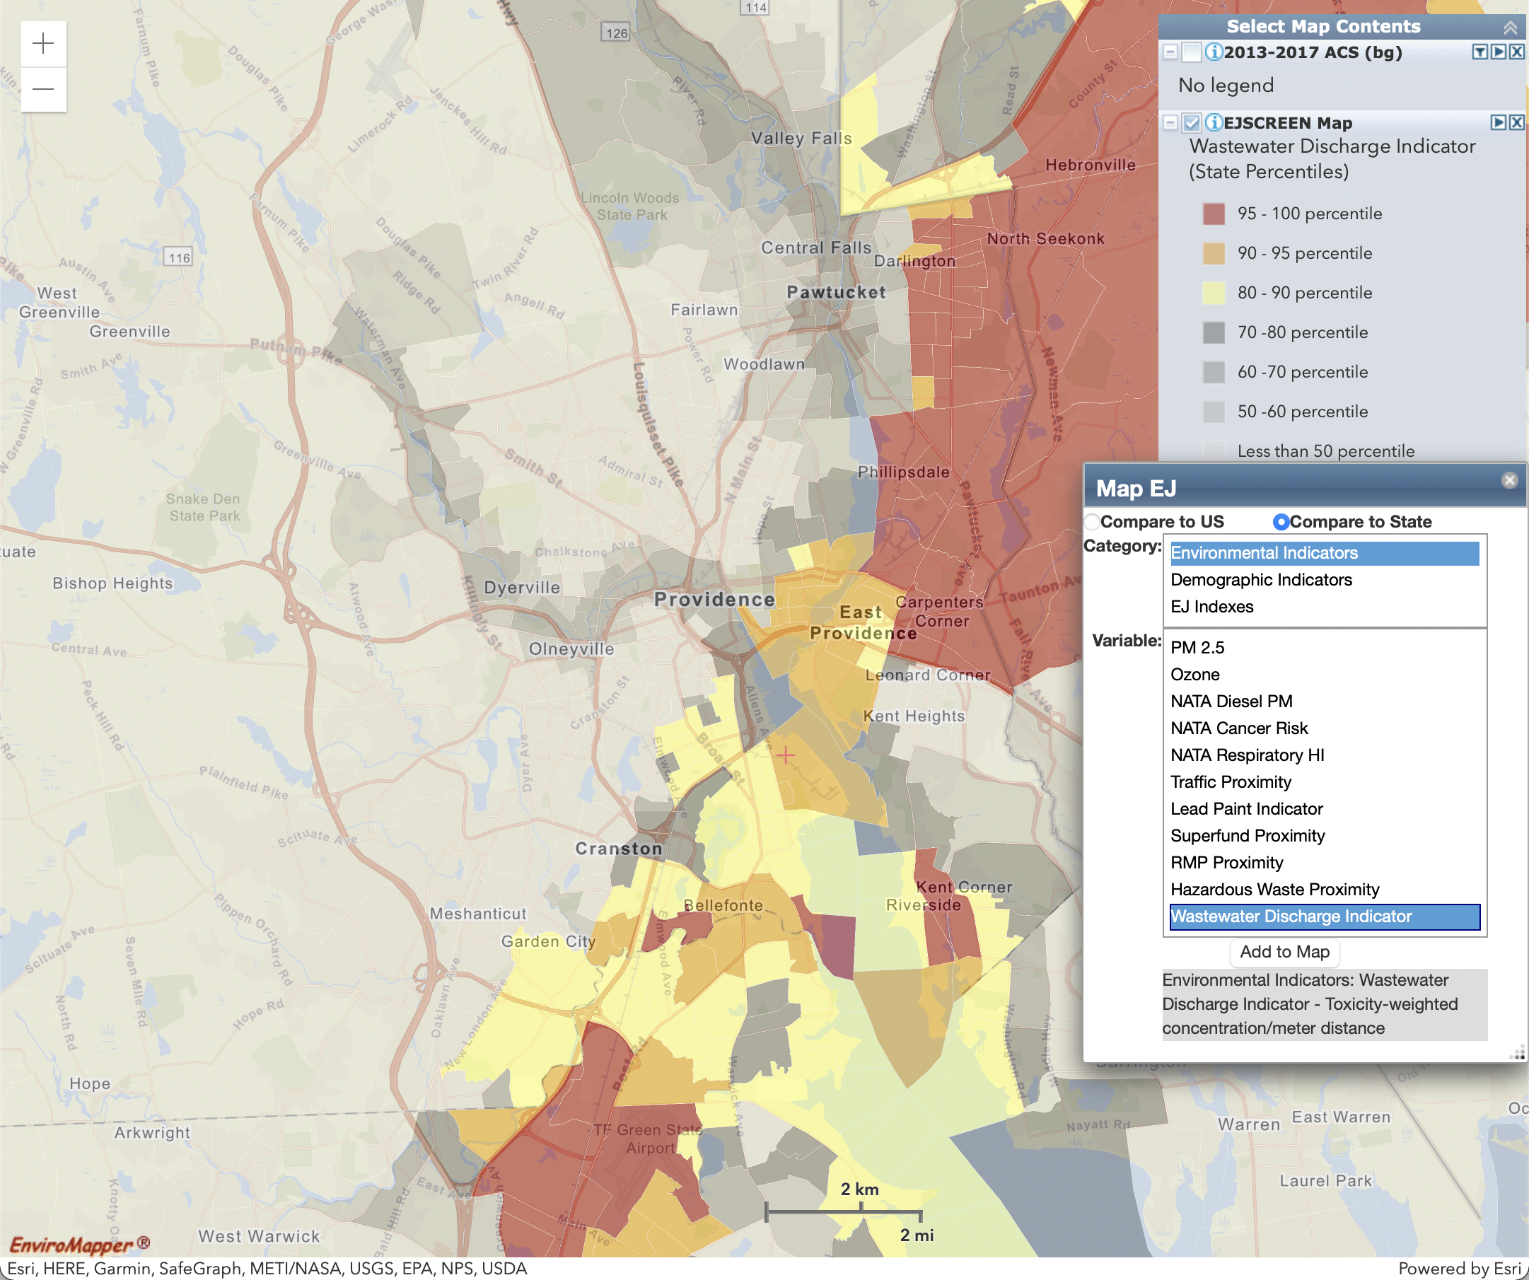
Environmental Indicator: Wastewater Discharge Indicator
RSEI modeled Toxic Concentrations at stream segments within 500 meters, divided by distance.
Statewide (Block Group)
Providence Metro Inset (Census Tract)

Slide 15
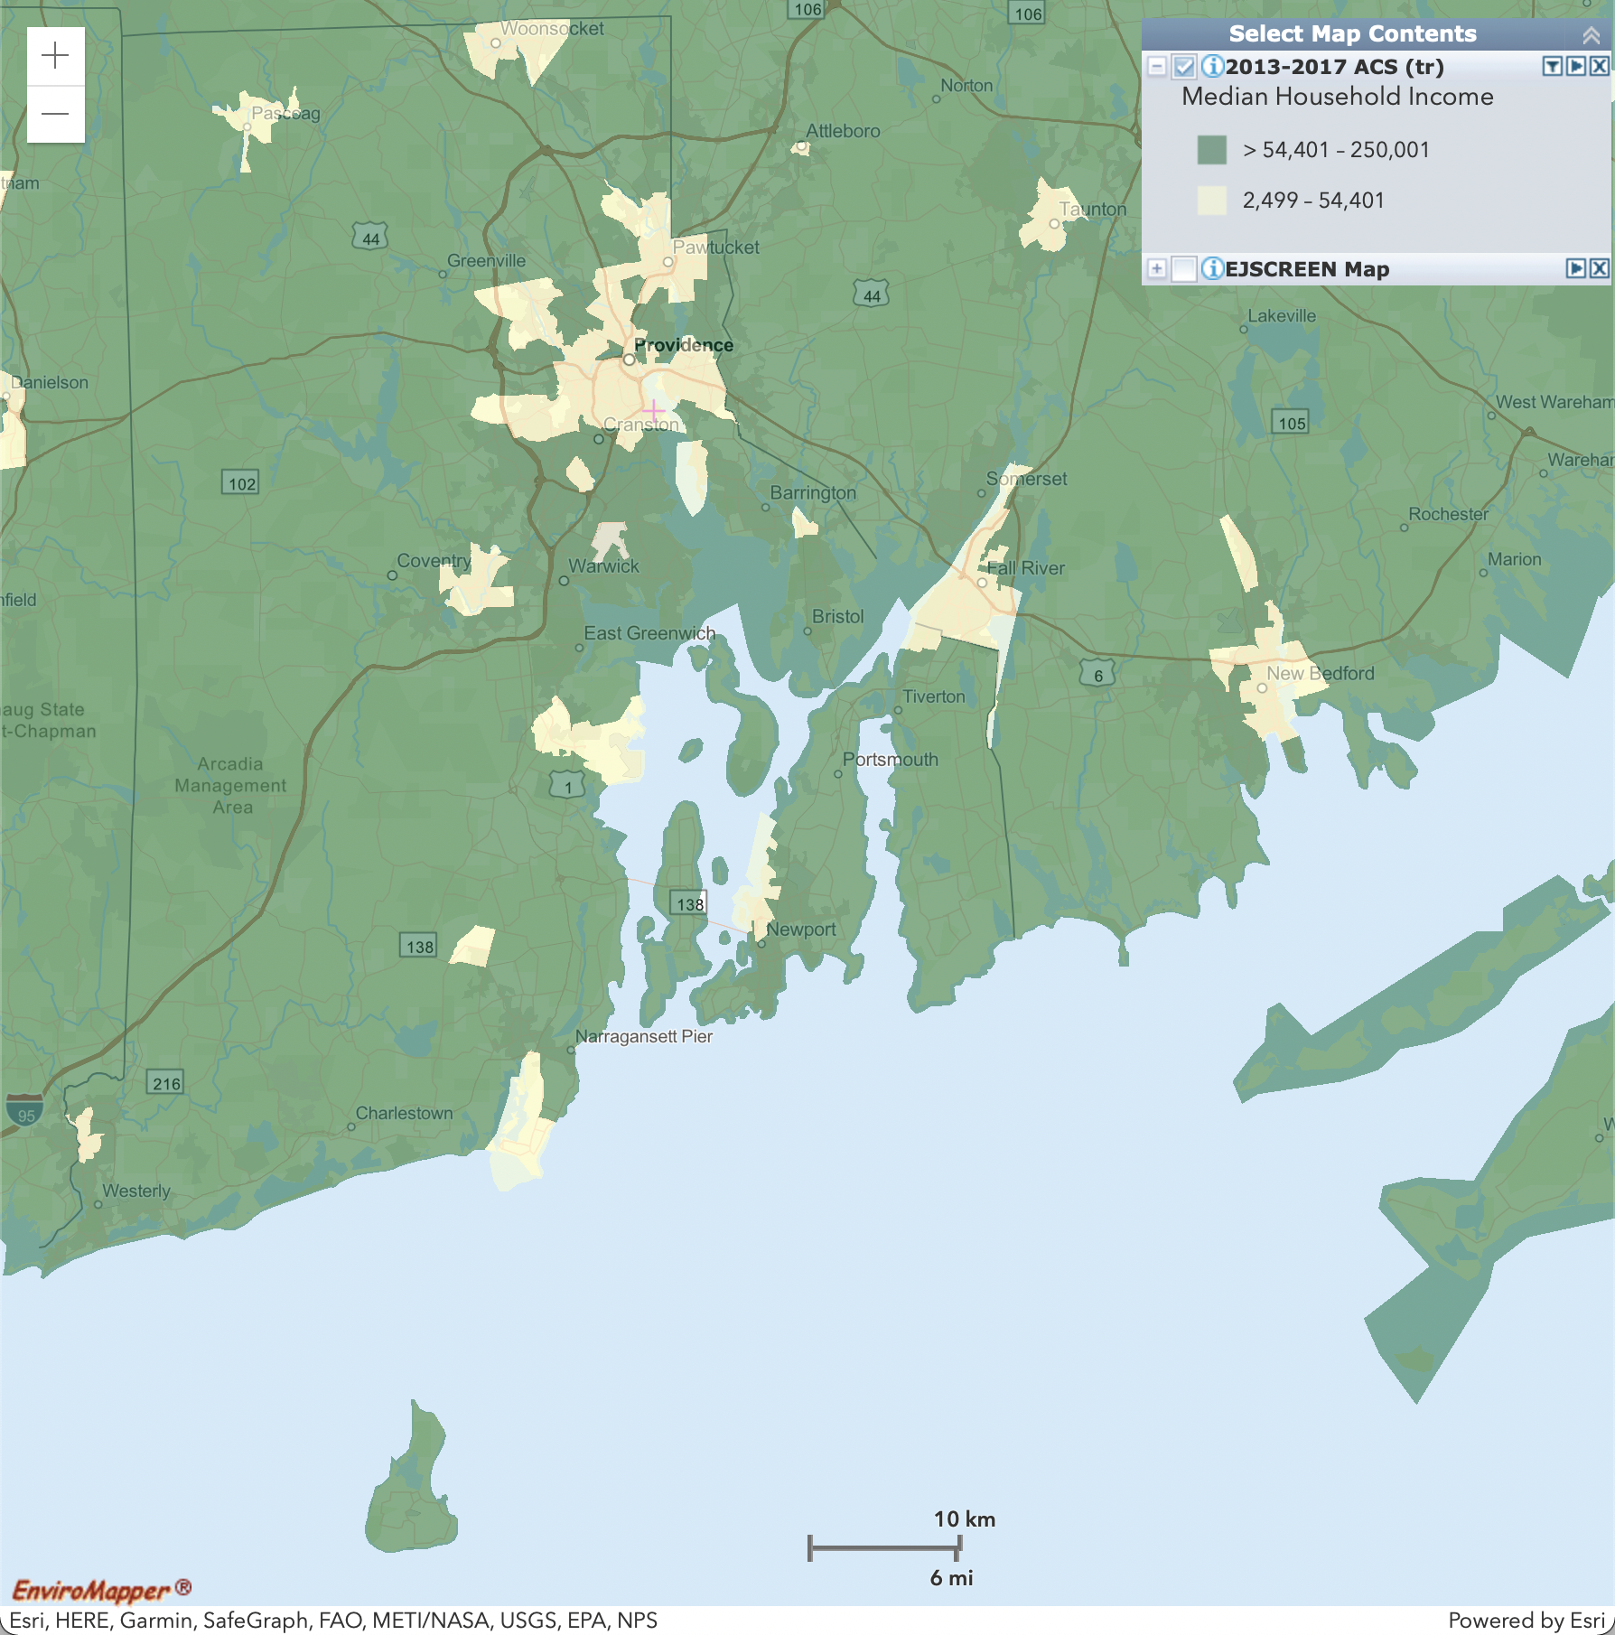
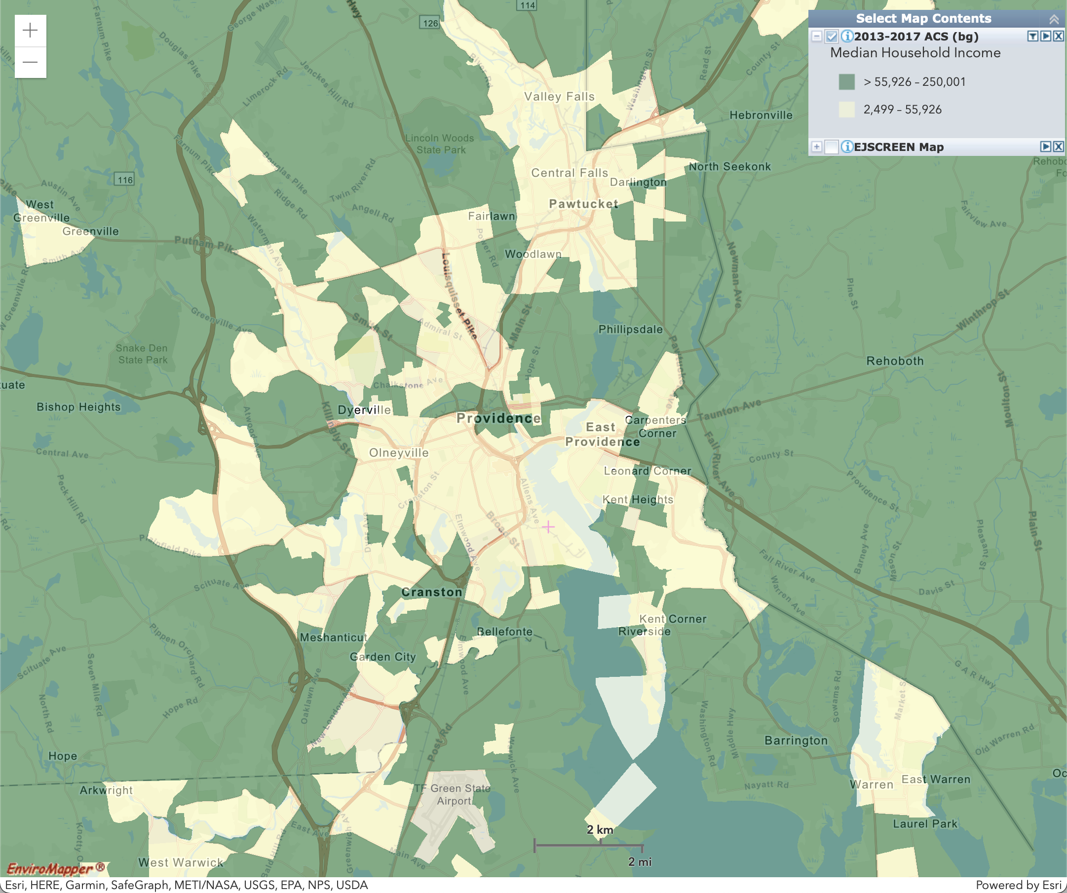
Demographic: Median Household Income
Areas where Median Household Income is less than approximately 80% ($51,472) of the statewide Median Household Income ($64,340)
Statewide (Block Group)
Providence Metro Inset (Census Tract)

Slide 16
Recommendations
Remove Ozone, Superfund Proximity, RMP Proximity, and Wastewater Discharge Indicator as triggering indicators. These indicators do not align in either definition or geographically with communities that should be considered overburdened. This will additionally prevent industrial Quonset Point from becoming an Overburdened Community.
Reduce number of indicators needed to trigger Overburdened Community from 3 to 2. This is due to the reduction in the number of triggering indicators from eleven to seven.
Raise income percentage that allows for the possibility of an Overburdened Community to 100% of Median Household Income to include more census tracts that should be but are not currently considered overburdened and to avoid non-Overburdened “island” Communities that could be used to effectively site polluting infrastructure in Overburdened Communities.
While these maps give a good indication of which Census Tracts have triggering indicators, it is not immediately intuitive exactly which Census Tracts would be defined as Overburdened Communities in both the original or recommended definitions due to the complexity of multiple layers of data. Data should be obtained from the EPA and analyzed outside of the EJSCREEN tool to determine exactly which Census Tracts would be considered Overburdened Communities under both definitions.

Slide 17
Overburdened Community: Recommended Definition
(a) “Overburdened Community” means any Census Tract in Rhode Island that:
(1) Is at or above the seventy fifth (75th) statewide percentile for at least two (2) of the following Environmental Indicators on the most recent available United States Environmental Protection Agency’s EJSCREEN Assessment: (a) PM 2.5; (b) NATA Diesel PM; (c) NATA Cancer Risk; (d) NATA Respiratory Hazard Index; (e) Traffic Proximity; (f) Lead Paint Indicator; (g) Hazardous Waste Proximity; and
(2) Has a median household income, as calculated by the US Census Bureau, that is no greater than one hundred (100) percent of the statewide median household income, as calculated by the US Census Bureau.

